Slide 1
Migration from analog to digital communications
The first step to move from analog to digital communications is to digitize the analog signal
This can be accomplished by using analog to digital converter
The analog to digital converter is composed from three different processes

Slide 2
Analog to digital A/D converter
Sampling, which is explained in details in the previous semester
Quantization process
Binary encoding, convert each quantized value into a binary code word
m(t)
m[n]=m[nT_{s}]
v[nT_{s}]

Slide 3
Quantization
Quantization is the process of converting continuous amplitude samples $m(nT_{s})$ of a continuous message signal $m(t)$ at time $t=nT_{s}$ into a discrete amplitude $v(nT_{s})$ taken from a finite set of possible amplitudes
This process is illustrated graphically in the next slide

Slide 4
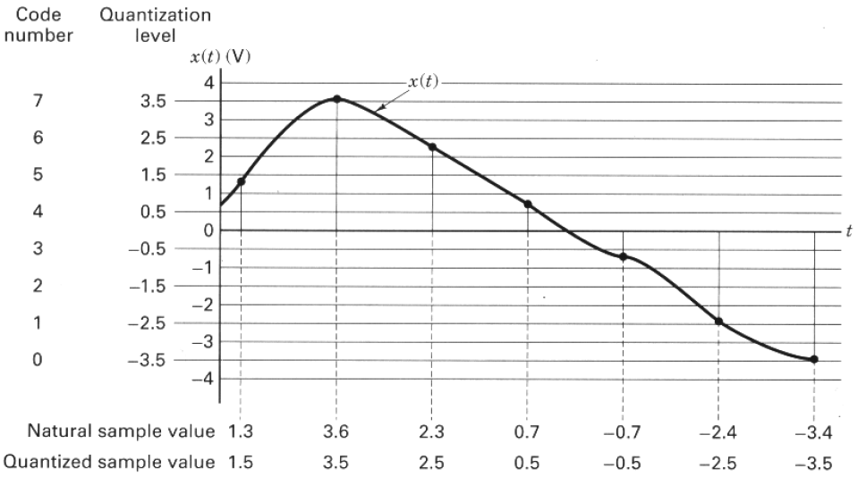
Quantization

Slide 5
Uniform and non uniform quantization
Quantizers can be classifieds into uniform or non uniform
In uniform quantizers the step size is equally spaced between the adjacent levels
In non uniform step size $∆$ is made variable according to the sample amplitude

Slide 6
Uniform quantization
simplest
Most popular
Conceptually of great importance
The input output characteristics of the quantizer are
Staircase-like
Non-linear
Qunatizers can be classifieds into midtread or midrise

Slide 7
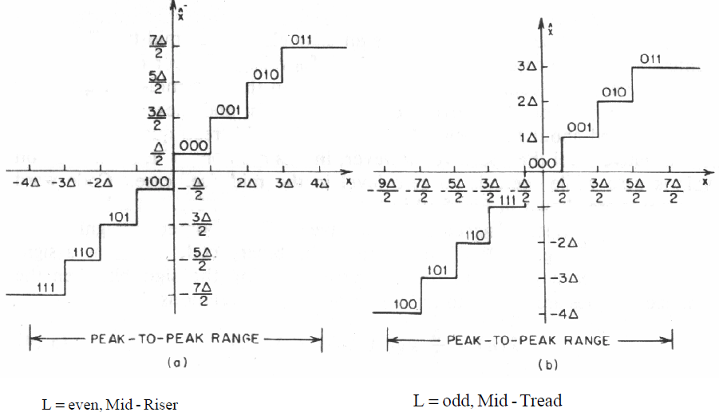
Midtread and midrise quantizers
Quantized level
Quantized level
Input level

Slide 8
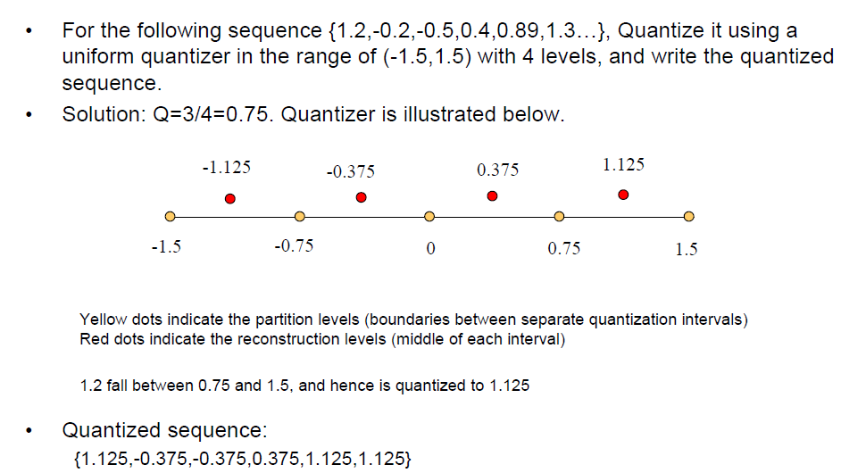
Quantization example

Slide 9
Quantization noise
The use of quantization introduces an error between the input signal $m$ and the output signal $v$ known as the quantization noise
The quantization error is defined as $q=m−v$
The value of the quantization noise will be $±\frac{∆}{2}$, where $∆$ is the step size

Slide 10
pdf of the quantization noise
Usually the quantizer input $m$ is a sample value of zero-mean random variable $M$
This means that the qunatization noise is a random variable which can be expressed as $Q=M−V$
Now we need to find and expression for the signal to quantization noise ratio

Slide 11
Signal to quantization noise ratio
Consider the input signal $m$ of continuous amplitude in the range $\left(−m_{max},m_{max}\right),$
The step size $∆$ will be defined as $∆=\frac{{2m}_{max}}{L}$, where $L is the total number oflevels$
For a uniform quantization, the quantization error will be bounded between by $\frac{−∆}{2}≤q≤\frac{∆}{2}$

Slide 12
Signal to quantization noise ratio
If the number of quantization levels $L$ is sufficiently large ( $∆$ is small), we can assume that the quantization error $Q$ is uniformly distributed
This means that the pdf of Q can be written as
$$f_{Q}\left(q\right)=\left\{\begin{matrix}\frac{1}{∆} & −\frac{∆}{2}≤q≤\frac{∆}{2} \\ 0 & otherwise\end{matrix}\right\}$$

Slide 13
Signal to quantization noise ratio
With the mean of the quantization error being zero, its variance
$${σ2}_{Q}^{}=E[Q2]$$
$=\int_{−\frac{∆}{2}}^{\frac{∆}{2}}{q^{2}f_{Q}\left(q\right)dq}$
$${σ2}_{Q}^{}=\frac{1}{∆}\int_{−\frac{∆}{2}}^{\frac{∆}{2}}{q^{2}dq}=\frac{∆2}{12}$$

Slide 14
Signal to quantization noise ratio
With the mean of the quantization error being zero, its variance
$${σ2}_{Q}^{}=E[Q2]$$
$=\int_{−\frac{∆}{2}}^{\frac{∆}{2}}{q^{2}f_{Q}\left(q\right)dq}$
$${σ2}_{Q}^{}=\frac{1}{∆}\int_{−\frac{∆}{2}}^{\frac{∆}{2}}{q^{2}dq}=\frac{∆2}{12}$$

Slide 15
Signal to quantization noise ratio
Recall that $∆=\frac{2m_{max}}{L}$
For binary representation the number of levels can be written as
$L=2^{R}, where is the total number of bits$
By substituting the values of $L$ and $∆$ in ${σ2}_{Q}$we have
$${σ2}_{Q}^{}=\frac{1}{3}\frac{m2max}{2^{2R}}$$

Slide 16
Signal to quantization noise ratio
If the average power of the message signal $m(t)$is denoted by $P$, then the signal to noise ratio at the output of the quantizer
$$\left(SNR\right)O=\left(\frac{3P}{{m2}_{max}^{}}\right)2^{2R}$$
Note that the signal to noise ratio at the output of the quantizer can be increased by increasing the number of bits or number of levels

Slide 17
Standard number of bits for audio A/D
Standard audio A/D converters uses 8 bits, while 16 bits are used in sound cards in PC system

Slide 18
Example 1
A given A/D converter is excited by a sine wave whose peak amplitude is $A_{m}$, determine the signal to noise ratio dB if 5 are used in the quantizer, repeat the problem if 8 bits are used

Slide 19
Solution
The average power in a sinusoidal wave is given by
$P_{av}=\frac{{A2}_{m}}{2}$
The signal to noise ration can be found from the expression $\left(SNR\right)O=\left(\frac{3P}{{m2}_{max}^{}}\right)2^{2R}$
as
$$\left(SNR\right)O=\left(\frac{3\frac{{A2}_{m}}{2}}{A^{2}m}\right)2^{2R}=\frac{3}{2}2^{2R}$$

Slide 20
Solution
Converting the previous expression to dB, we can write
$$10log{\left(SNR\right)}_{O}=1.8+6R$$
For $R=5, \left(SNR\right)O=31.8 dB$
For $R=8, \left(SNR\right)O=49.8 dB$

