Slide 1
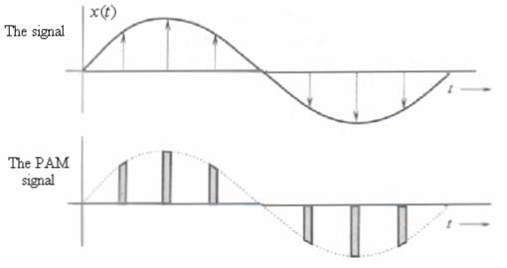
Time division multiplexing TDM
The sampling theorem states that a given message signal $m(t)$ can be transmitted as a sequence of samples of $m(nT_{s})$ as shown
m(t)
5T_{s}
6T_{s}
7T_{s}
T_{s}
2T_{s}
3T_{s}
4T_{s}

Slide 2
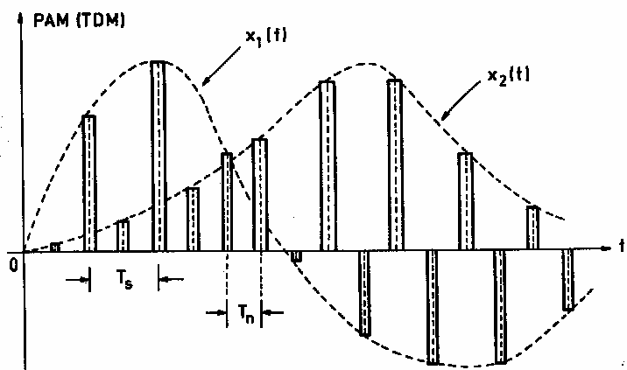
TDM graphical representation for two signals
This leaves space for other samples to be interleaved in the same sampling interval

Slide 3
TDM block diagram
In TDM N signals can be transmitted simultaneously using a single channel
This can be achieved by using the block diagram shown below
Communication channel

Slide 4
TDM block diagram
The commutator switch takes samples from each input signal and interleave them
The operating frequency of the commutator switch is given by $f_{N}={Nf}_{s}$
Where $f_{s}={2f}_{m}$ is the sampling frequency for each signal provided that all N signals have the same bandwidth

Slide 5
TDM block diagram
If the N signals have different bandwidths, then $f_{s}$ is selected as the sampling frequency of the signal with the highest frequency content
If signals with different bandwidths are to be TDM multiplexed, then the signals with same bandwidth are grouped together and sampled on the same $f_{s}$

Slide 6
TDM example
Two signals are to be transmitted using PAM TDM. The first signal has a bandwidth of 0-8 kHz, the second signal bandwidth is 0-10 kHz. The two signals are sampled equally. The sampled signals are passed through a low pass filter before transmission

Slide 7
TDM example
What is the minimum clock frequency of the PAM system (commutator clock)
What is the minimum cutoff frequency of the low pass filter used before transmission that will preserve the amplitude information on the output pulses

Slide 8
TDM example
What would be the minimum bandwidth if theses two signals were frequency multiplexed using normal AM techniques and SSB techniques

Slide 9
Example 1 solution
The minimum clock frequency of the PAM system can be found from
The minimum bandwidth of the transmission filter can be found from

Slide 10
Example 1 solution
The above equation for the bandwidth can be concluded from the fact that, the transmitted samples can be viewed as a new signal $f_{3}(t)$ sampled at a sampling rate of $T_{n}$
This sampling rate is equivalent to a frequency $f_{N}=\frac{1}{T_{n}}=2f_{m3}$

Slide 11
Example 1 solution
Where $f_{m3}$ is the maximum frequency content of $f_{3}(t)$
From the above discussion we can see that the cutoff frequency of the filter must be greater than the $f_{m3}=\frac{1}{{2T}_{n}}$ in order to pass $f_{3}\left(t\right)$ without distortion

Slide 12
Example 1 solution
If the previous two signals were frequency multiplexed, then sent using AM carrier, then the minimum bandwidth would be
If SSB modulation is used then the bandwidth would be

Slide 13
5.88
4.88

