Slide 1
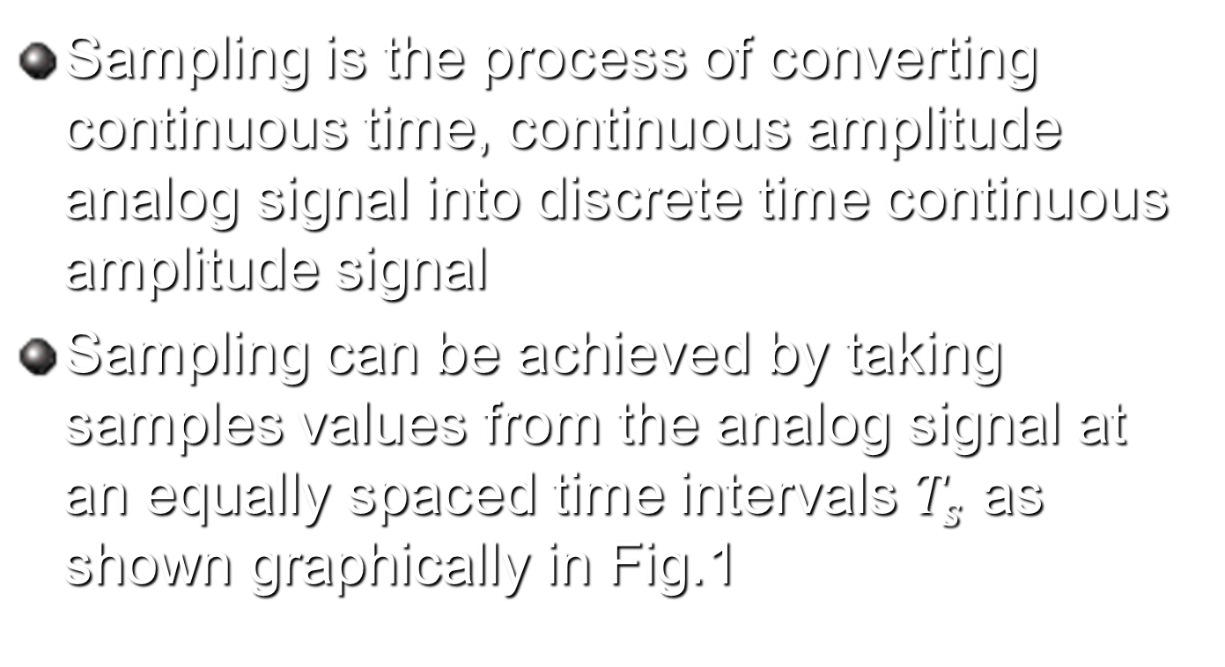
Sampling process
Sampling is the process of converting continuous time, continuous amplitude analog signal into discrete time continuous amplitude signal
Sampling can be achieved by taking samples values from the analog signal at an equally spaced time intervals $T_{s}$ as shown graphically in Fig.1

Slide 2
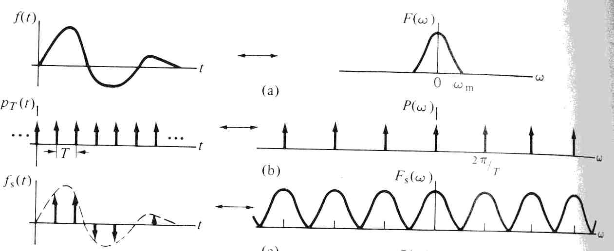
Sampling process
Fig.1

Slide 3
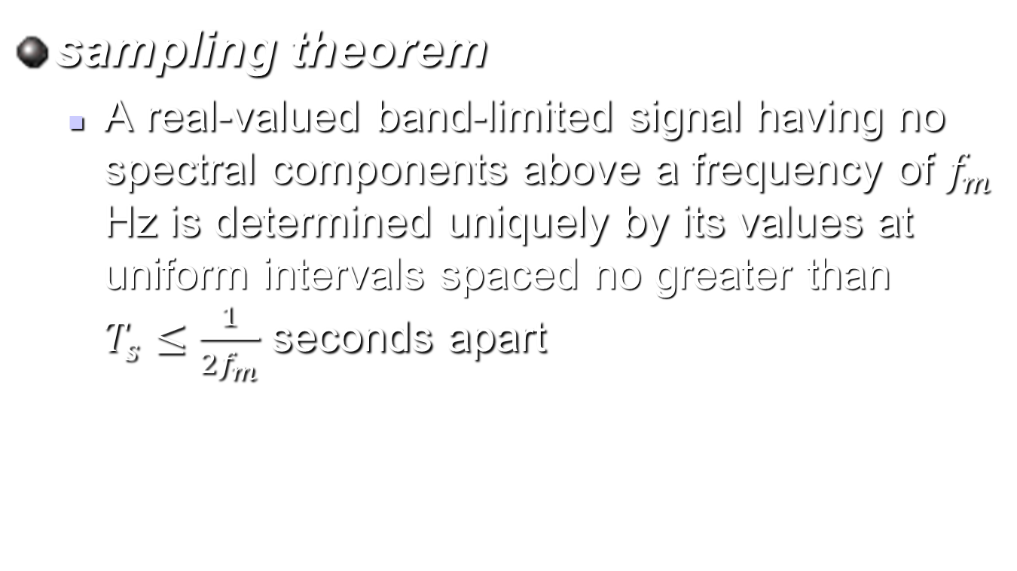
Sampling
sampling theorem
  A real-valued band-limited signal having no spectral components above a frequency of $f_{m}$ Hz is determined uniquely by its values at uniform intervals spaced no greater than $T_{s}≤\frac{1}{{2f}_{m}}$ seconds apart

Slide 4
Sampling types
There are three sampling types available, these are
  Ideal sampling
  Natural sampling
  Flat top sampling

Slide 5
Ideal sampling
In ideal sampling the analog signal is multiplied by a delta comb functions as shown in Fig. 2
Fig.2

Slide 6
Ideal sampling
Ideal sampling is used to explain the main concept of sampling theoretically
In practical life Ideal sampling can not be achieved, because there is no practical circuit which generates exact delta comb function

Slide 7
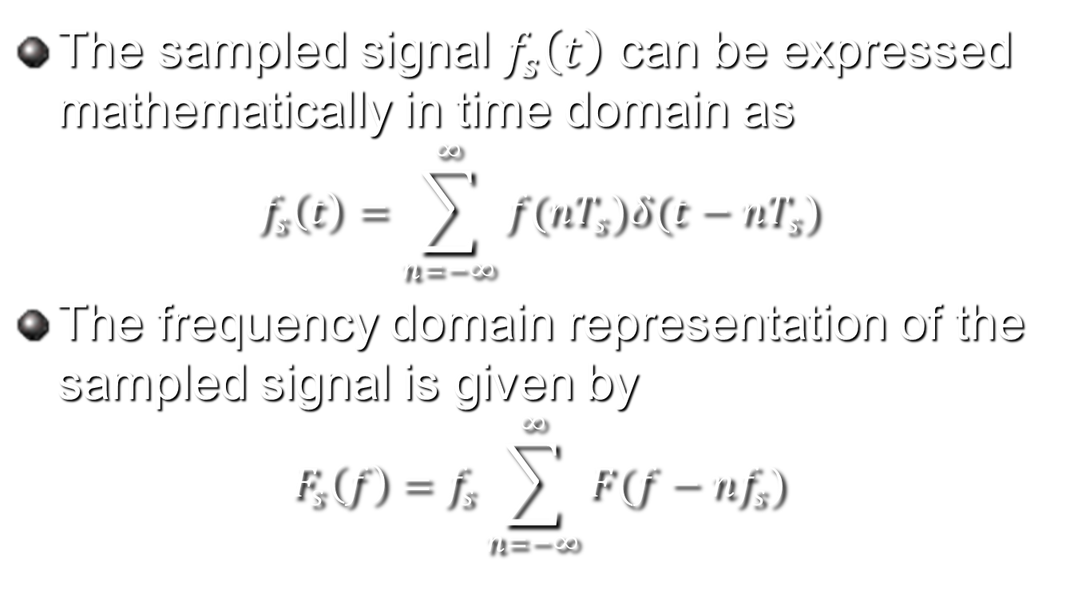
Mathematical representation of ideal sampling
The sampled signal $f_{s}\left(t\right)$ can be expressed mathematically in time domain as
$$f_{s}\left(t\right)=\sum_{n=−∞}^{∞}{f(nT_{s})δ(t−nT_{s})}$$
The frequency domain representation of the sampled signal is given by
$$F_{s}\left(f\right)=f_{s}\sum_{n=−∞}^{∞}{F(f−nf_{s})}$$

Slide 8
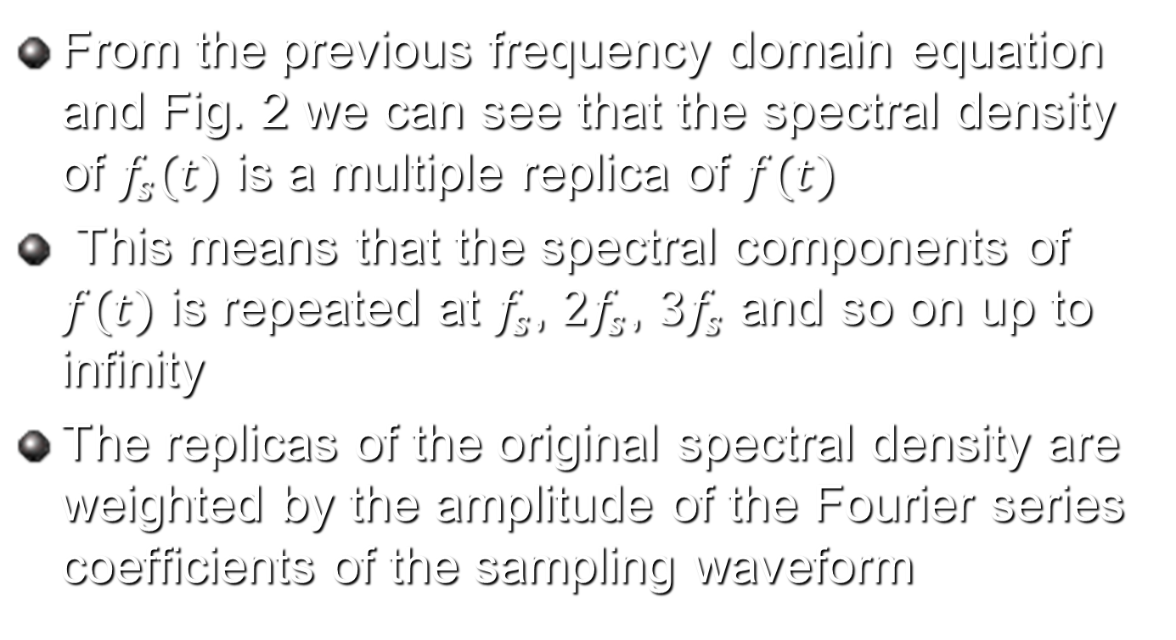
Sampling
From the previous frequency domain equation and Fig. 2 we can see that the spectral density of $f_{s}(t)$ is a multiple replica of $f(t)$
This means that the spectral components of $f(t)$ is repeated at $f_{s}$, ${2f}_{s}$, ${3f}_{s}$ and so on up to infinity
The replicas of the original spectral density are weighted by the amplitude of the Fourier series coefficients of the sampling waveform

Slide 9
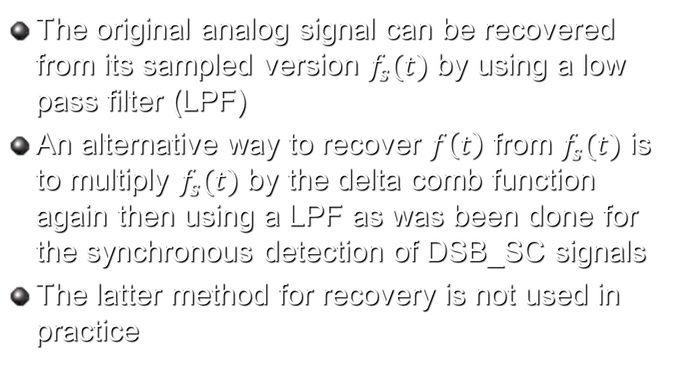
Recovering the message signal from the sampled signal
The original analog signal can be recovered from its sampled version $f_{s}(t)$ by using a low pass filter (LPF)
An alternative way to recover $f\left(t\right)$ from $f_{s}(t)$ is to multiply $f_{s}(t)$ by the delta comb function again then using a LPF as was been done for the synchronous detection of DSB_SC signals
The latter method for recovery is not used in practice

Slide 10
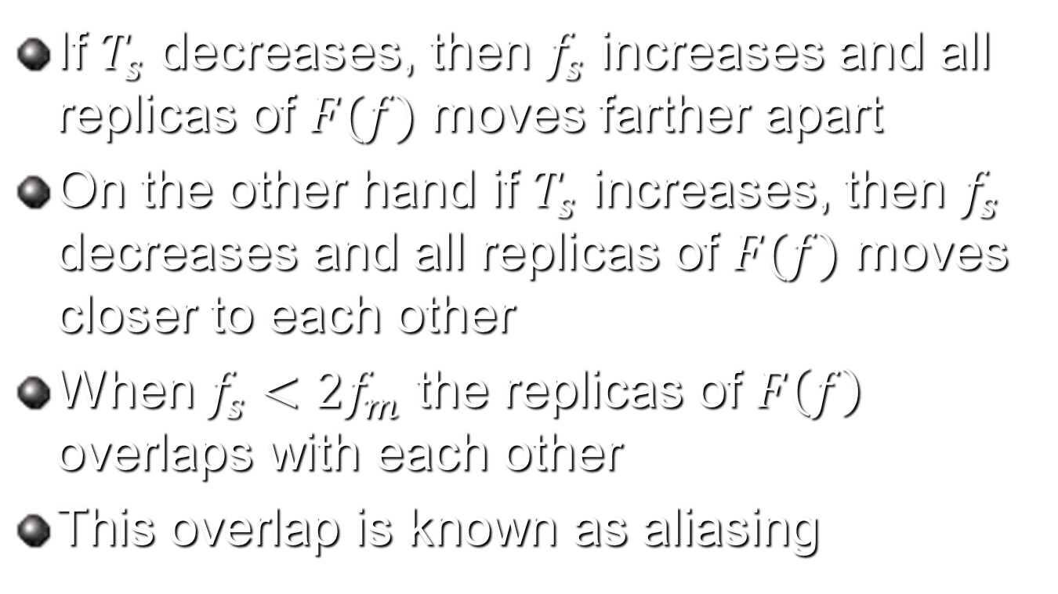
Effects of changing the sampling rate
If $T_{s}$ decreases, then $f_{s}$ increases and all replicas of $F(f)$ moves farther apart
On the other hand if $T_{s}$ increases, then $f_{s}$ decreases and all replicas of $F(f)$ moves closer to each other
When $f_{s}<2f_{m}$ the replicas of $F\left(f\right)$ overlaps with each other
This overlap is known as aliasing

Slide 11
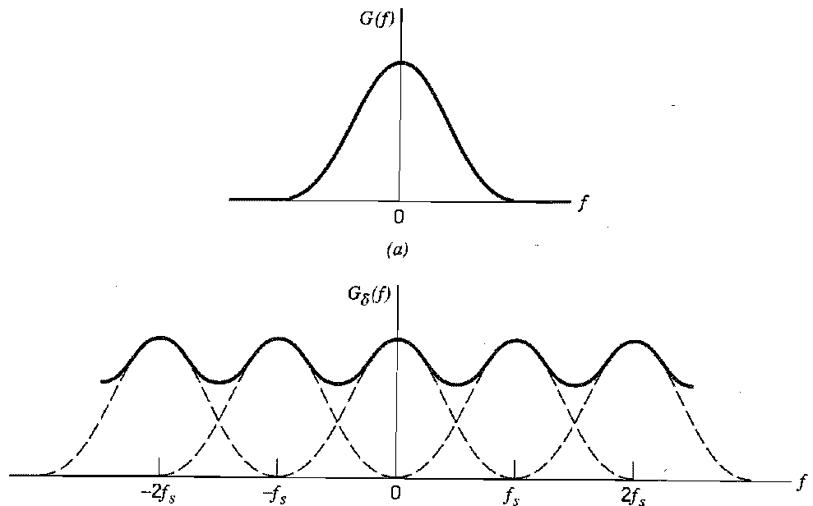

Aliasing effect
If the sampling frequency is selected below the Nyquist frequency $f_{s}<2f_{m}$, then $f_{s}\left(t\right)$ is said to be under sampled and aliasing occurs as shown in Fig. 3
Fig. 3

Slide 12
Time limited signals and anti aliasing filtering
In real life applications there are some signals which are time limited such as rectangular or triangular pulses
Those signals will have an infinite spectral components when analyzed using Fourier analysis
Those signal will suffer from aliasing since the sampling frequency should be infinite in order to avoid aliasing

Slide 13
Time limited signals and anti aliasing filtering
This means the sampling frequency would not be practical
In order to limit the bandwidth of the time limited signal, a LPF filter is used
This filter is know as anti alias filter

Slide 14
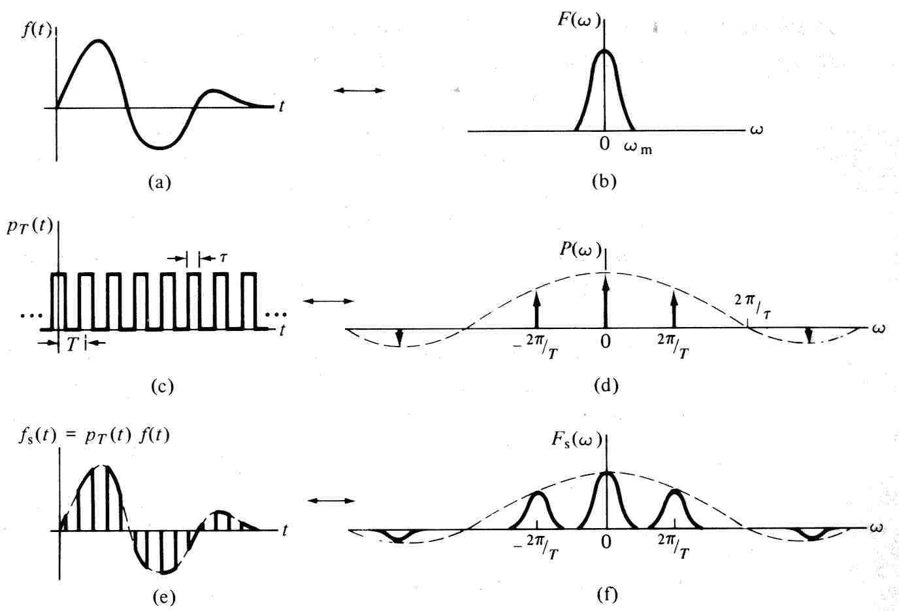

Natural sampling
In natural sampling the information signal $f(t)$ is multiplied by a periodic pulse train with a finite pulse width τ as shown below

Slide 15
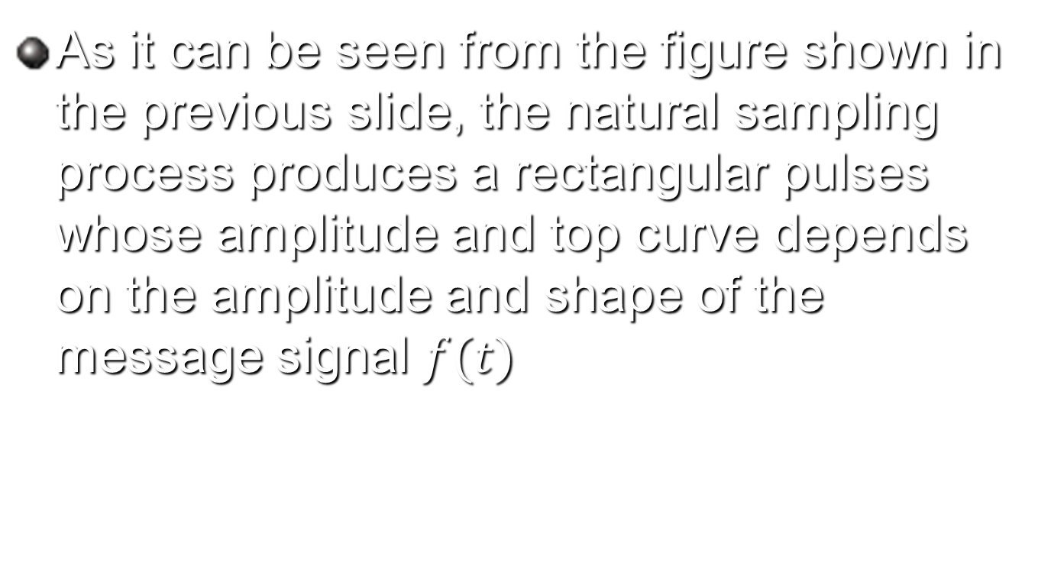
Natural sampling
As it can be seen from the figure shown in the previous slide, the natural sampling process produces a rectangular pulses whose amplitude and top curve depends on the amplitude and shape of the message signal $f(t)$

Slide 16

Recovering $f(t)$ from the naturally sampled signal
As we have did in the ideal sampling, the original information signal can be recovered from the naturally sample version by using a LPF

Slide 17
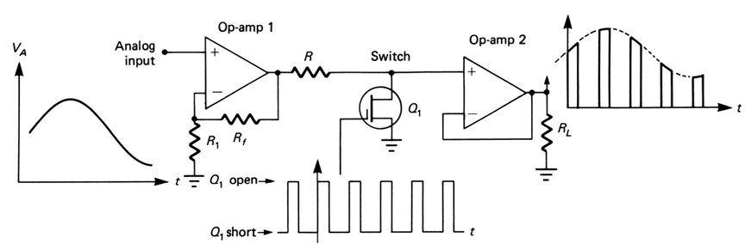
Generation of Natural Sampling
The circuit used to generate natural sampling is shown Below

Slide 18
Generation of Natural Sampling
The FET in the is the switch used as a sampling gate
When the FET is on, the analog voltage is shorted to ground; when off, the FET is essentially open, so that the analog signal sample appears at the output
Op-amp 1 is a noninverting amplifier that isolates the analog input channel from the switching function

Slide 19
Generation of Natural Sampling
Op-amp 2 is a high input-impedance voltage follower capable of driving low-impedance loads (high “fanout”).
The resistor R is used to limit the output current of op-amp 1 when the FET is “on” and provides a voltage division with rd of the FET. (rd, the drain-to-source resistance, is low but not zero)

Slide 20
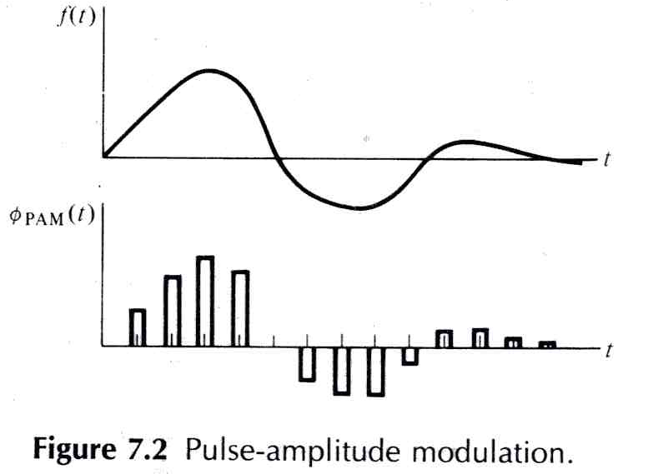
Pulse amplitude modulation PAM (flat top) sampling
In flat top (PAM) sampling the amplitude of a train of constant width pulses is varied in proportion to the sample values of the modulating signal as shown below

Slide 21
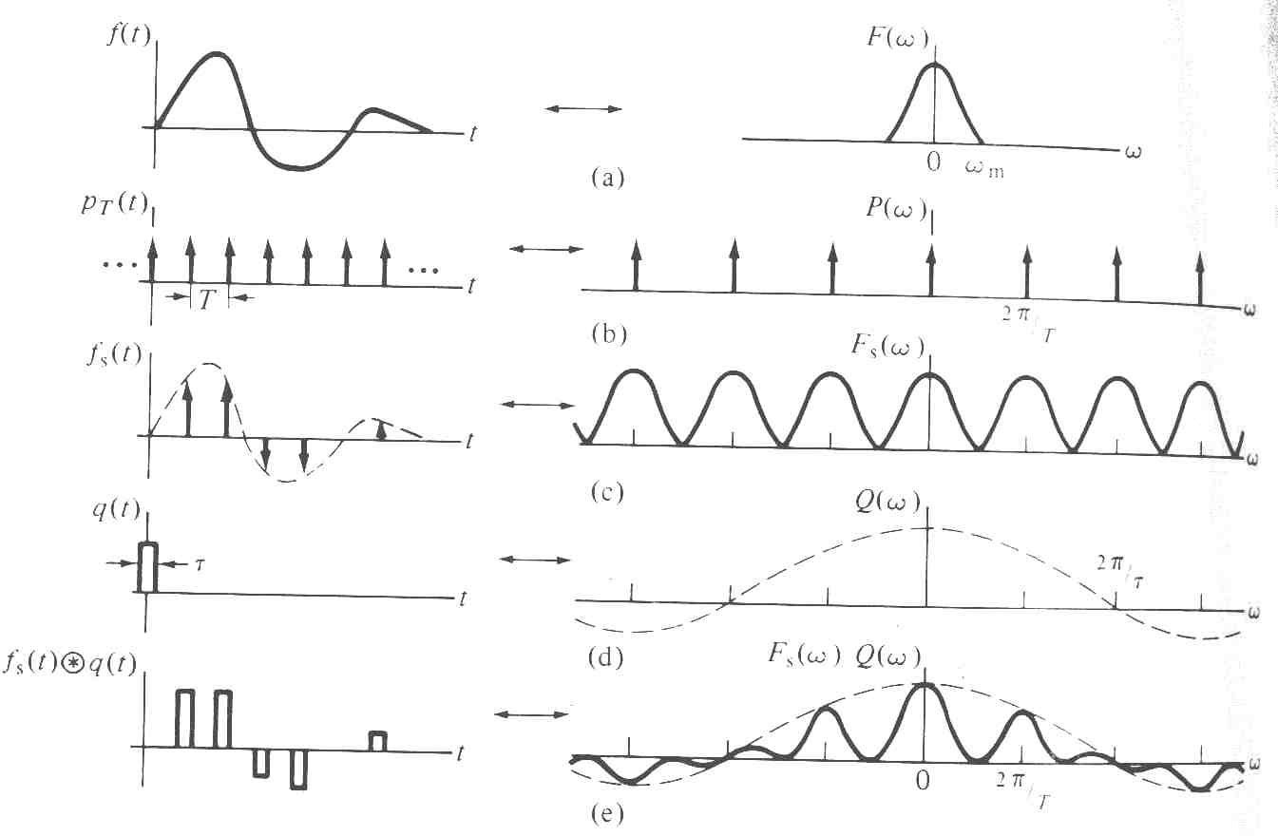
Pulse amplitude modulation PAM (flat top) sampling
In PAM, the pulse tops are flat
The generation of PAM signals can be viewed as shown below

Slide 22
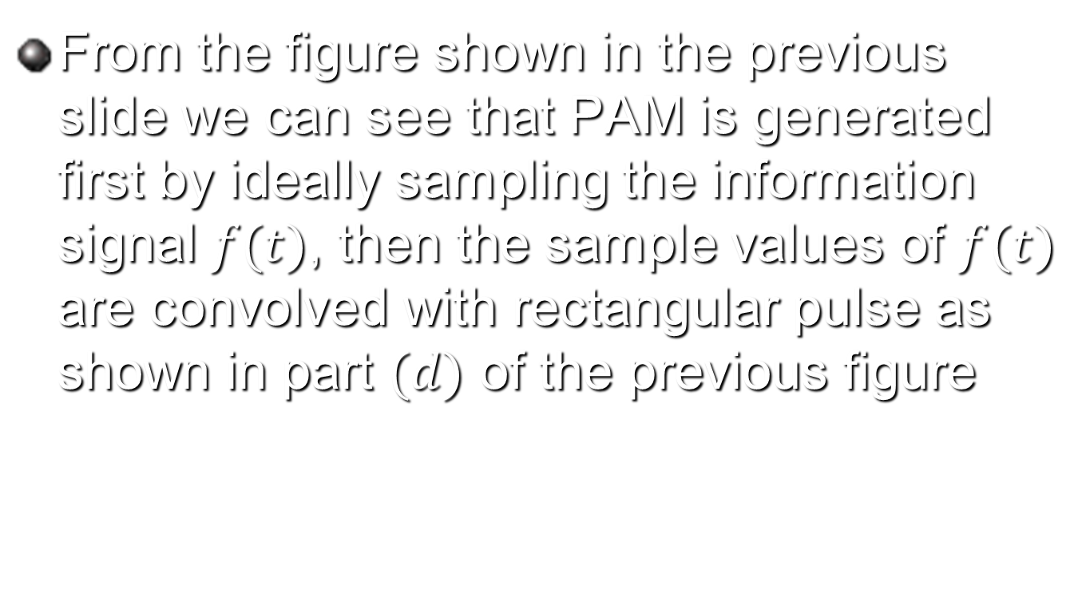
Pulse amplitude modulation PAM (flat top) sampling
From the figure shown in the previous slide we can see that PAM is generated first by ideally sampling the information signal $f(t)$, then the sample values of $f(t)$ are convolved with rectangular pulse as shown in part $(d)$ of the previous figure

Slide 23
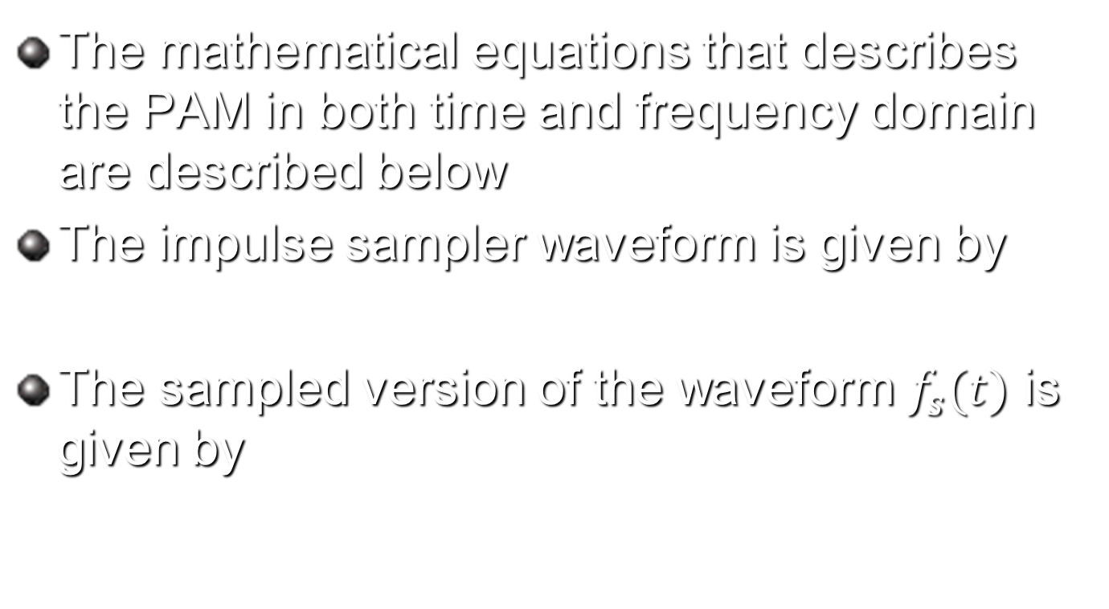
Pulse amplitude modulation PAM (flat top) sampling
The mathematical equations that describes the PAM in both time and frequency domain are described below
The impulse sampler waveform is given by
The sampled version of the waveform $f_{s}(t)$ is given by

Slide 24
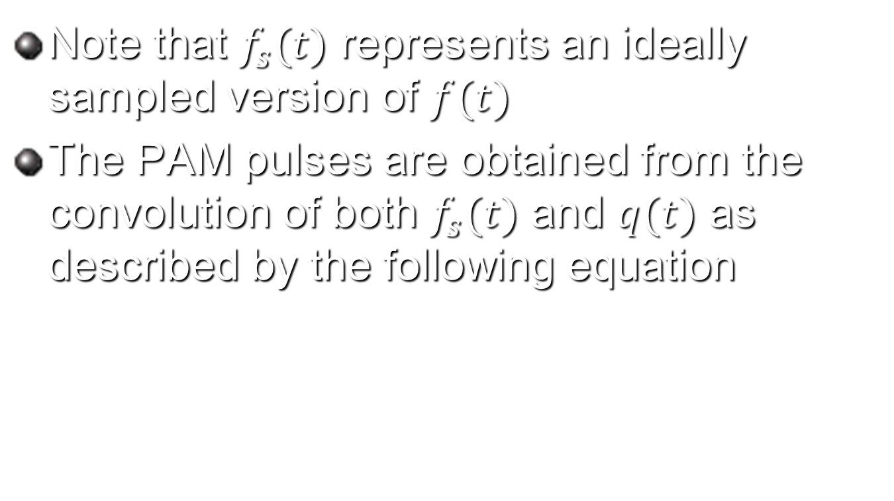
Pulse amplitude modulation PAM (flat top) sampling
Note that $f_{s}(t)$ represents an ideally sampled version of $f(t)$
The PAM pulses are obtained from the convolution of both $f_{s}(t)$ and $q(t)$ as described by the following equation

Slide 25
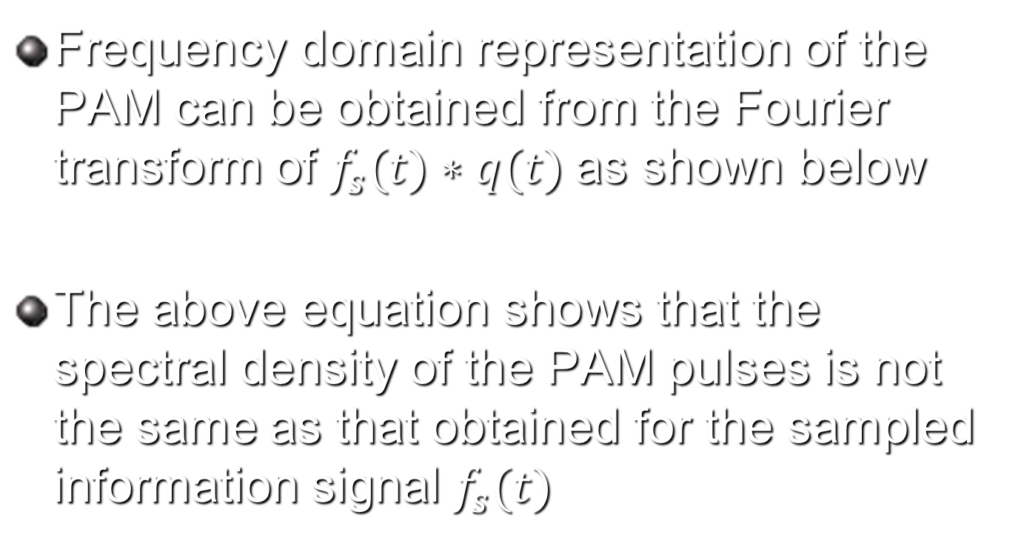
Pulse amplitude modulation PAM (flat top) sampling
Frequency domain representation of the PAM can be obtained from the Fourier transform of $f_{s}(t)∗q(t)$as shown below
The above equation shows that the spectral density of the PAM pulses is not the same as that obtained for the sampled information signal $f_{s}(t)$

Slide 26
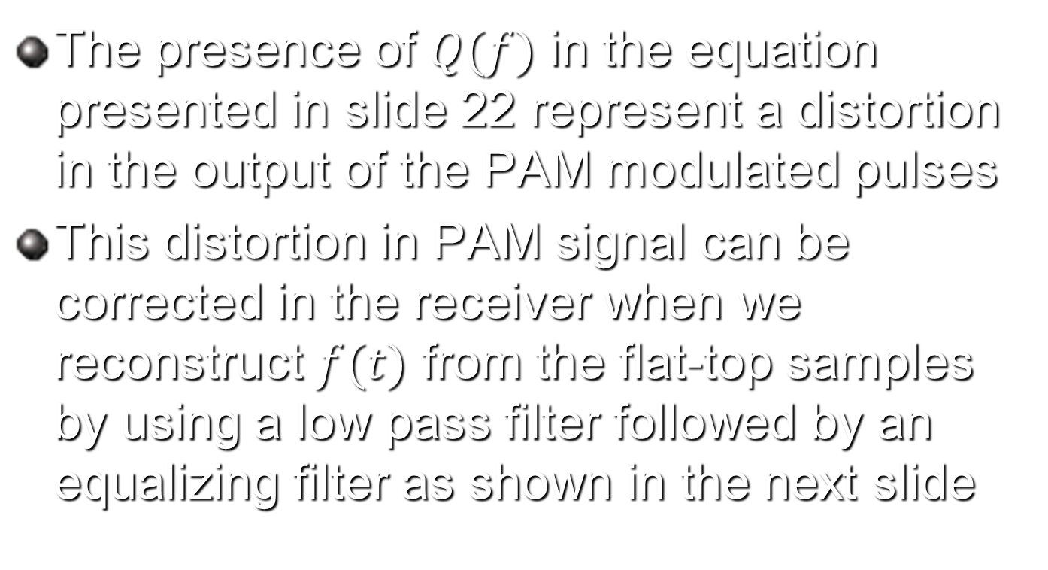
Pulse amplitude modulation PAM (flat top) sampling
The presence of $Q(f)$ in the equation presented in slide 22 represent a distortion in the output of the PAM modulated pulses
This distortion in PAM signal can be corrected in the receiver when we reconstruct $f(t)$ from the flat-top samples by using a low pass filter followed by an equalizing filter as shown in the next slide

Slide 27
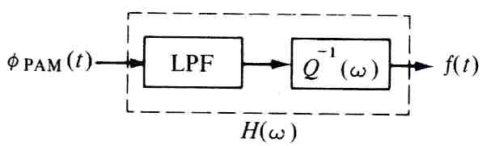
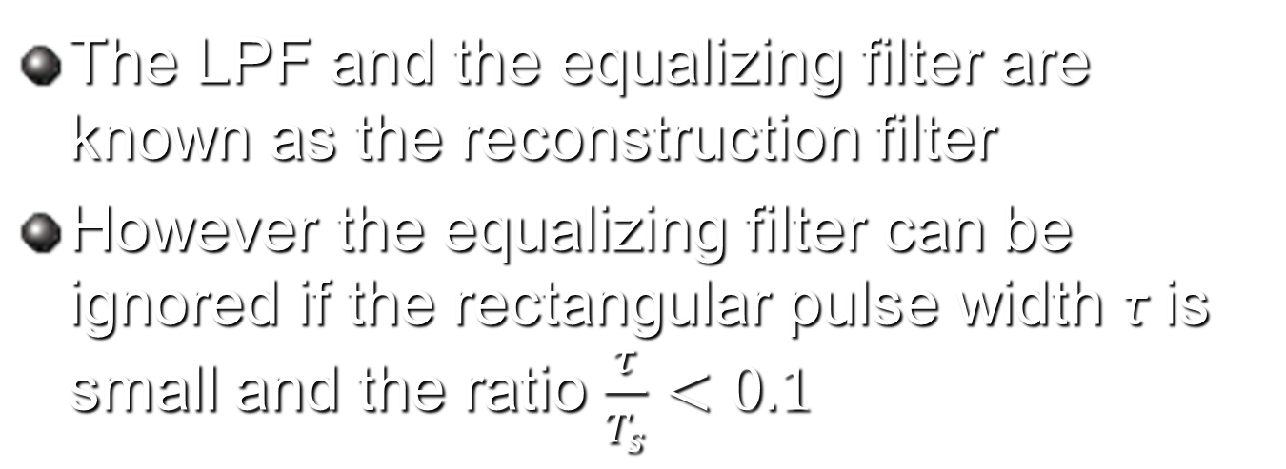
Recovering of f(t) from the PAM samples
The LPF and the equalizing filter are known as the reconstruction filter
However the equalizing filter can be ignored if the rectangular pulse width τ is small and the ratio $\frac{τ}{T_{s}}<0.1$

Slide 28
Why PAM is so common in communication although it generates spectral distortion
The reasons for using flat top sampling in communications are
  The shape of the pulse is not important to convey the information
  The rectangular pulse is an in easy shape to generate

Slide 29
Why PAM is so common in communication although it generates spectral distortion
  When signals are transmitted over long distances repeaters are used. If the pulse shape is used to convey the information then repeaters must amplify the signal and therefore increase the amount of noise in the system. However if the repeaters regenerate the signal rather than amplifying it then no extra noise components will be added and the signal to noise ratio became better for PAM system compared with natural sampling

Slide 30
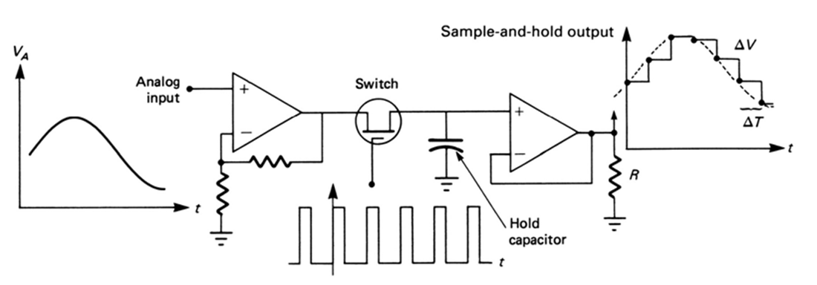
Generation of flat top samples
Falt top sampling can be generated by a circuit know as sample and hold circuit shown below

Slide 31
Generation of flat top samples
As seen in Figure, the instantaneous amplitude of the analog (voice) signal is held as a constant charge on a capacitor for the duration of the sampling period Ts

Slide 32
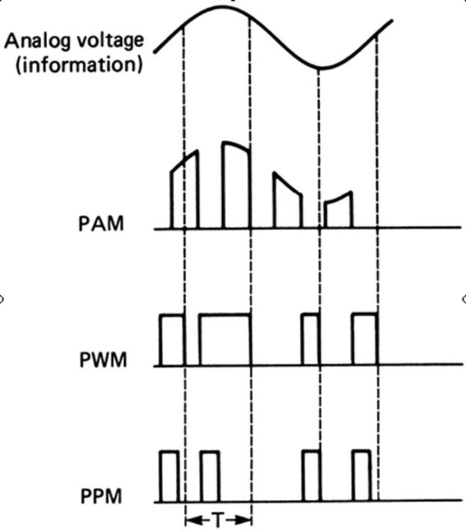
Pulse width and pulse position modulation

Slide 33
Pulse width and pulse position modulation
In pulse width modulation (PWM), the width of each pulse is made directly proportional to the amplitude of the information signal
In pulse position modulation, constant-width pulses are used, and the position or time of occurrence of each pulse from some reference time is made directly proportional to the amplitude of the information signal
PWM and PPM are compared and contrasted to PAM in Figure.

Slide 34
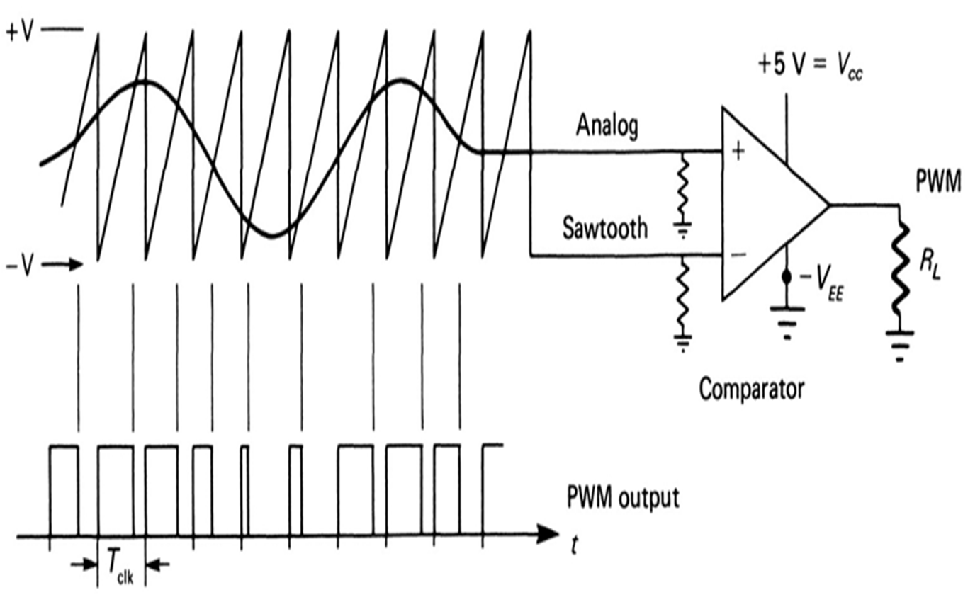
Generation of PWM

Slide 35
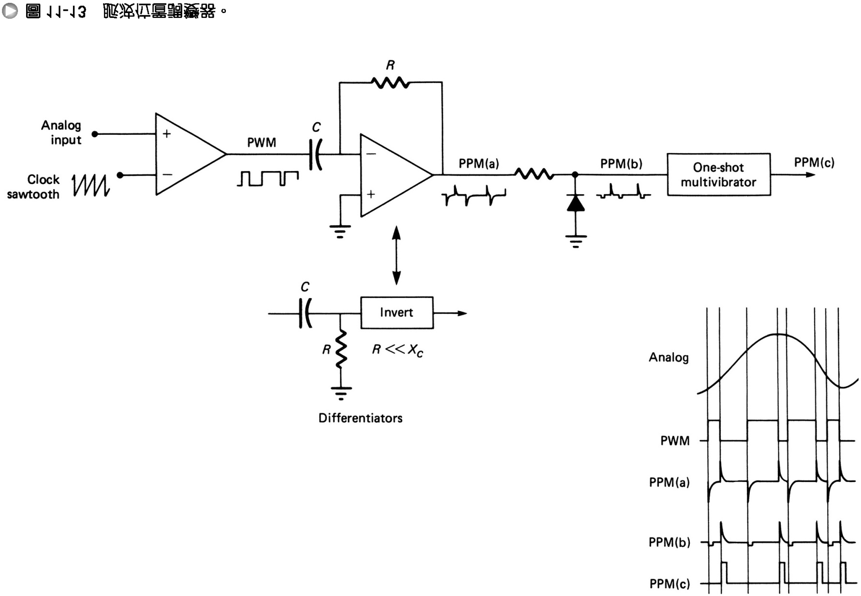
Generation of PPM

Slide 36

Sampling example
A waveform, $x\left(t\right)=10\cos\left(1000πt+\frac{π}{3}\right)+20cos (2000πt+\frac{π}{6})$ is to be uniformly sampled for digital transmission
What is the maximum allowable time interval between sample values that will ensure perfect signal reproduction?
If we want to reproduce 1 minute of this waveform, how many sample values need to be stored?
Two analog signals $m_{1}(t)$ and $m_{2}(t)$ are to be transmitted over a common channel by means of time-division multiplexing. The highest frequency of $m_{1}(t)$ is 3 kHz, and that of $m_{2}(t)$ is 3.5 kHz. What is the minimum value of the permissible sampling rate?

Slide 37

Solution
The maximum allowable time interval between samples $T_{s}$ can be found from the sampling theorem as $T_{s}≤\frac{1}{f_{s}}≤\frac{1}{2×f_{m}}≤\frac{1}{2×\frac{2000}{2π}}≤15.707 ms$
The number of samples per minute is equal to
$$R_{s}=number of samples per second×60$$
$$R_{s}=f_{s}×60=2×\frac{2000}{2π}×60=38.197 Ksample$$
The minimum value of the sampling rate will be $f_{s}≥2f_{m}≥2×3.5 kHz≥7 kHz$

