Slide 1
Analog to digital conversion
The first step to move from analog to digital communications is to digitize the analog signal
This can be accomplished by using an analog to digital converter A/D
The analog to digital converter is composed from three different processes

Slide 2
Analog to digital A/D converter
Sampling, which is explained in details
Quantization process
Binary encoding, convert each quantized value into a binary code word
m(t)
m[n]=m[nT_{s}]
v[nT_{s}]

Slide 3
Quantization
Quantization is the process of converting continuous amplitude samples $m(nT_{s})$ of a continuous message signal $m(t)$ at time $t=nT_{s}$ into a discrete amplitude $v(nT_{s})$ taken from a finite set of possible amplitudes
This process is illustrated graphically in the next slide

Slide 4
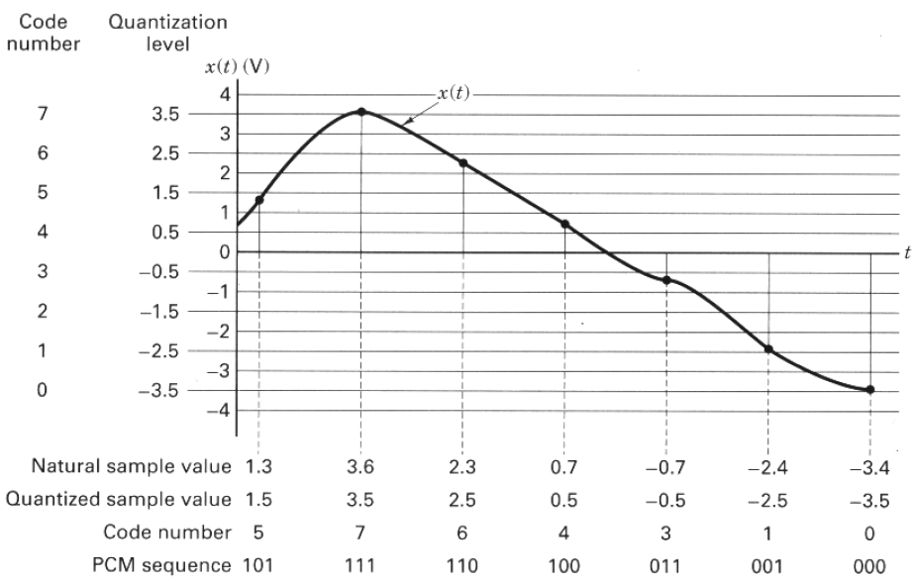
Quantization

Slide 5
Uniform and non uniform quantization
Quantizers can be classifieds into uniform or non uniform
In uniform quantizers the step size is equally spaced between the adjacent levels
In non uniform step size $∆$ is made variable according to the sample amplitude

Slide 6
Uniform quantization
simplest
Most popular
Conceptually of great importance
The input output characteristics of the quantizer are
Staircase-like
Non-linear
Qunatizers can be classifieds into midtread or midrise

Slide 7
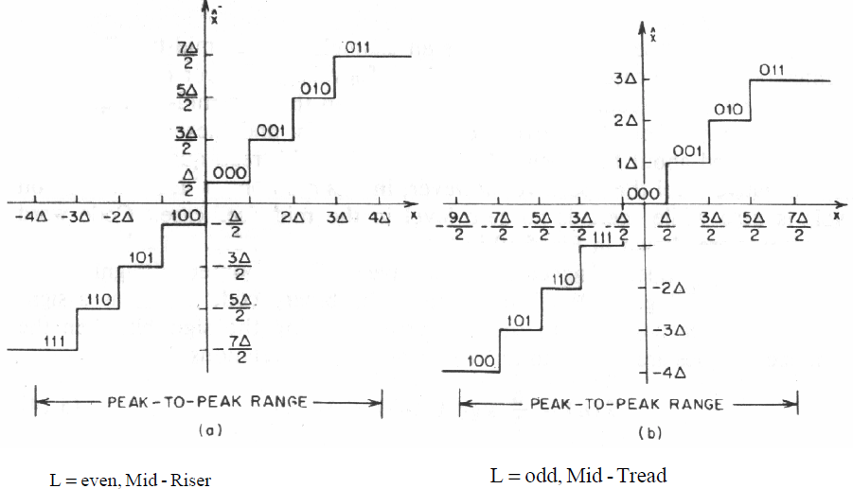
Midtread and midrise quantizers
Quantized level
Quantized level
Input level

Slide 8
Quantization noise
The use of quantization introduces an error between the input signal $m$ and the output signal $v$ known as the quantization noise
The quantization error is defined as $q=m−v$
The value of the quantization noise will be $±\frac{∆}{2}$, where ∆ is the step size

Slide 9
pdf of the quantization noise
Usually the quantizer input $m$ is a sample value of zero-mean random variable $M$
This means that the quantization noise is a random variable which can be expressed as $Q=M−V$
Now we need to find and expression for the signal to quantization noise ratio

Slide 10
Signal to quantization noise ratio
Consider the input signal $m$ of continuous amplitude in the range $\left(−m_{max},m_{max}\right),$
The step size $∆$ will be defined as $∆=\frac{{2m}_{max}}{L}=\frac{m_{pp}}{L}$, where $L is the total number oflevels$

Slide 11
Signal to quantization noise ratio
If the number of quantization levels $L$ is sufficiently large ( $∆$ is small), we can assume that the quantization error $Q$ is uniformly distributed
This means that the pdf of $Q$ can be written as
$$f_{Q}\left(q\right)=\left\{\begin{matrix}\frac{1}{∆} & −\frac{∆}{2}≤q≤\frac{∆}{2} \\ 0 & otherwise\end{matrix}\right\}$$

Slide 12
Signal to quantization noise ratio
With the mean of the quantization error being zero, its variance
$${σ2}_{Q}^{}=E[Q2]$$
$=\int_{−\frac{∆}{2}}^{\frac{∆}{2}}{q^{2}f_{Q}\left(q\right)dq}$
$${σ2}_{Q}^{}=\frac{1}{∆}\int_{−\frac{∆}{2}}^{\frac{∆}{2}}{q^{2}dq}=\frac{∆2}{12}$$
Note that the variance represents the average ac power contained in the noise

Slide 13
Signal to quantization noise ratio
Recall that $∆=\frac{2m_{max}}{L}$
For binary representation the number of levels can be written as
$$L=2^{R}, where is the total number of bits$$
By substituting the values of $L$ and $∆$ in ${σ2}_{Q}$we have
$${σ2}_{Q}^{}=\frac{1}{3}\frac{m2max}{2^{2R}}$$

Slide 14
Signal to quantization noise ratio
If the average power of the message signal $m(t)$is denoted by $P$, then the signal to noise ratio at the output of the quantizer
$$\left(SNR\right)O=\left(\frac{3P}{{m2}_{max}^{}}\right)2^{2R}$$
Note that the signal to noise ratio at the output of the quantizer can be increased by increasing the number of bits or number of levels

Slide 15
Standard number of bits for audio A/D
Standard audio A/D converters uses 8 bits, while 16 bits are used in sound cards in PC system

Slide 16
Example 1
A given A/D converter is excited by a sine wave whose peak amplitude is $A_{m}$, determine the signal to noise ratio in dB if 5 bits are used in the quantizer, repeat the problem if 8 bits are used

Slide 17
Solution
The average power in a sinusoidal wave is given by
$P_{av}=\frac{{A2}_{m}}{2}$
The signal to noise ration can be found from the expression $\left(SNR\right)O=\left(\frac{3P}{{m2}_{max}^{}}\right)2^{2R}$
as
$$\left(SNR\right)O=\left(\frac{3\frac{{A2}_{m}}{2}}{A^{2}m}\right)2^{2R}=\frac{3}{2}2^{2R}$$

Slide 18
Solution
Converting the previous expression to dB, we can write
$$10log{\left(SNR\right)}_{O}=1.8+6R$$
For $R=5, \left(SNR\right)O=31.8 dB$
For $R=8, \left(SNR\right)O=49.8 dB$

Slide 19
Example 2
The information in analog waveform, with a maximum frequency $f_{m}=3 kHz$, is to be transmitted over an M-ary PAM system, where the number of PAM levels is $L=16$. The quantization distortion is specified not to exceed $±1\%$ of the peak to peak analog signal

Slide 20
Example 2 Relation between the number of bits and the noise level
What is the minimum number of bits/sample, or bits/PCM that should be used in digitizing the analog waveform
What is the minimum required sampling rate, and what is the resulting bit transmission rate
What is the PAM pulse or symbol transmission rate?
If the transmission bandwidth (including filtering) equals 12 kHz, determine the bandwidth efficiency of this system

Slide 21
Solution example 2
Note that the maximum quantization error does not exceed $q≤\frac{∆}{2}$. It is also defined for this example as $q=0.01m_{pp}$. Equating both equations
$\begin{aligned}\frac{∆}{2}=0.01m_{pp} \\ \\ \frac{1}{2}\frac{m_{pp}}{2^{R}}=0.01m_{pp}\end{aligned}$ $\begin{aligned}R=\log_{2}\frac{1}{2×0.01}=5.6 bits \\ or R≈6 bits\end{aligned}$

Slide 22
Solution example 2
According to the Nyquist criterion, the sampling rate would be $f_{s}=2f_{m}=6000 smples/second$. The bit transmission rate would be the number of bits multiplied by the sampling rate $R_{b}=R×f_{s}=6×6000=36000 bit/second$

Slide 23
Solution example 2
Since multilevel pulses are to be used with $l=2^{R}=16→R=4 bits/symbol$. Therefore the bit stream will be partitioned into groups of 4 bits to form the new 16-level PAM digits, and the resulting transmission rate is $R_{PAM}=\frac{R_{b}}{4}=\frac{36000}{4}=9000 symbols/second$

Slide 24
Solution example 2
The bandwidth efficiency is defined as the data throughput per hertz, $R_{b}\frac{R_{b}}{channel BW}=\frac{36000}{12000}=3\frac{bits}{s}/Hz$

Slide 25
non uniform quantization
Non uniform quantization is used in telephophonic communications
Analysis shows that the ratio of the peaks of the loud talks to the peaks of the weak talks is in the order of 1000 to 1
In non uniform step size $∆$ is made variable according to the sample amplitude

Slide 26
non uniform quantization
The use of a non uniform quantizer is equivalent to passing the baseband signal through a compressor and then applying the signal to a uniform quantizer
Two commonly used compression laws known as $μ−law and A−law$ can be applied to the signal to achieve compression

Slide 27
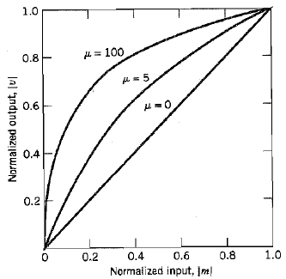
$μ−law$ compression law
The $μ−law$ is defined by $\left|v\right|=\frac{log⁡(1+μ\left|m\right|)}{log⁡(1+μ)}$ where $m$and $v$ are the normalized input and output of voltages, $μ$ is a positive integer

Slide 28
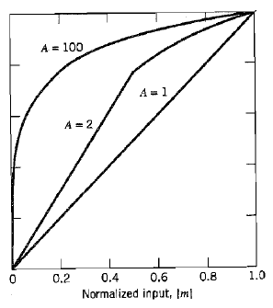
$A−law$ compression law
The $A−law$ is defined by $\left|v\right|=\left\{\begin{matrix}\frac{A\left|m\right|}{1+logA}, & 0≤\left|m\right|≤\frac{1}{A} \\ \frac{1+log⁡(A\left|m\right|)}{1+logA}, & \frac{1}{A}≤\left|m\right|≤1\end{matrix}\right\}$

Slide 29
Non uniform quantization
To restore the signal samples to their correct relative level in the receiver, an expander is used
The combination of a compressor and an expander is called compander
For both $μ−law$ and $A−law$, the dynamic range capability of the compander improves with increasing $μ$ and $A$

Slide 30
Non uniform quantization
The SNR for low level signals increases on the expenese of the SNR for high-level signals
A compromise is usually made in choosing the value of $μ$ and $A$
Typical values of $μ=255 and A=87.6$ are used

Slide 31
Pulse Code Modulation PCM
PCM is the most basic form of digital pulse modulation
PCM is accomplished by representing the signal in discrete form in both time and a amplitude
PCM can be described by the block diagram shown in the next slide

Slide 32
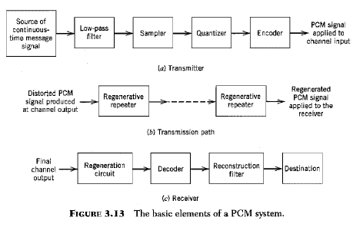
PCM block diagram
Anti alias filter

