Slide 1
Coherent phase shift keying
In coherent phase shift keying different phase modulation schemes will be covered i.e. binary PSK, quadrature phase shift keying and M-ary PSK
Binary PSK will be studied in the next slides

Slide 2
Binary Phase shift keying
In a coherent PSK system the pair of signals $s_{1}\left(t\right)$ and $s_{2}\left(t\right)$ are used to represent binary logics 1 and 0 respectively
$$s_{1}\left(t\right)=\sqrt{\frac{2E_{b}}{T_{b}}}\cos\left(2πf_{c}t\right)$$
$$s_{2}\left(t\right)=\sqrt{\frac{2E_{b}}{T_{b}}}\cos\left(2πf_{c}t+π\right)=−\sqrt{\frac{2E_{b}}{T_{b}}}\cos\left(2πf_{c}t\right)$$

Slide 3
Binary Phase shift keying
Where $0≤t≤T_{b}$, and $E_{b}$ is the transmitted signal energy per bit
The carrier frequency is selected such that $f_{c}=\frac{n}{T_{b}}$ so that each bit contains an integral number of cycles
From the pair of symbols $s_{1}(t)$ and $s_{2}(t)$ we can see only one basis function (carrier) is needed to represent both $s_{1}(t)$ and $s_{2}(t)$

Slide 4
Binary Phase shift keying
The basis function is given by
$$\begin{matrix}φ_{1}(t)=\sqrt{\frac{2}{T_{b}}}cos⁡(2πf_{c}t) & 0≤t≤T_{b}\end{matrix}$$
Now we can rewrite
$s_{1}\left(t\right)=\sqrt{E_{b}}φ_{1}(t)$and $s_{2}\left(t\right)=−\sqrt{E_{b}}φ_{1}(t)$on the interval $0≤t≤T_{b}$

Slide 5
Signal constellation for binary Phase shift keying
In order to draw the constellation diagram we need to find the projection of each transmitted symbol on the basis function
The projection of the logic (1); $S_{1}(t)$; is given by $S_{11}=\int_{0}^{T_{b}}{S_{1}}\left(t\right)φ_{1}\left(t\right)dt=+\sqrt{E_{b}}$
The projection of the second symbol $S_{2}(t)$ on the basis function is given by $S_{21}=\int_{0}^{T_{b}}{S_{2}}\left(t\right)φ_{1}\left(t\right)dt=−\sqrt{E_{b}}$

Slide 6
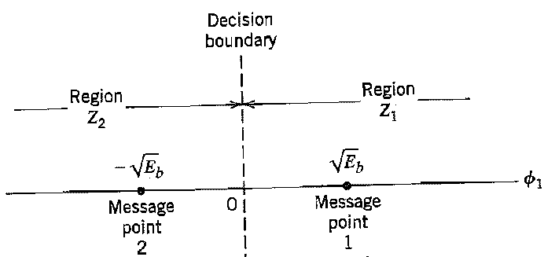
Signal constellation for binary Phase shift keying
If we plot the transmitted symbols for BPSK we may got the following constellation diagram

Slide 7
Error probability of BPSK
In order to compute the error probability of BPSK we partition the constellation diagram of the BPSK (see slide 6) into two regions
If the received symbol falls in region Z₁, the receiver decides in favor of symbol S₁ ( logic 1) was received
If the received symbol falls in region Z₂, the receiver decides in favor of symbol S₂ (logic 0) was received

Slide 8
Error probability of BPSK-Receiver model
The receiver in the pass band can be modeled as shown
The received signal vector $x(t)=s (t)+n(t)$

Slide 9
Error probability of BPSK
The observable element $x_{1}$ (symbol zero was sent and the detected sample was read in zone 1) is given by
$$x_{1}=\int_{0}^{T_{b}}{x_{1}\left(t\right)φ_{1}\left(t\right)dt}$$
$$x_{1}=\int_{0}^{T_{b}}{\left(s_{2}\left(t\right)+n\left(t\right)\right)φ_{1}\left(t\right)dt}$$
$$x_{1}=\int_{0}^{T_{b}}{s_{2}\left(t\right)φ_{1}\left(t\right)dt}=S_{21}=−\sqrt{E_{b}}$$

Slide 10
Error probability of BPSK
To calculate the probability of error that symbol 0 was sent and the receiver detect 1 mistakenly in the presence of AWGN with ${σ2}_{x}=\frac{N_{0}}{2}$, we need to find the conditional probability density of the random variable $x1$, given that symbol 0,$s_{2}\left(t\right)$ was transmitted as shown below

Slide 11
Error probability of BPSK
The conditional probability of the receiver deciding in favor of symbol 1, given that symbol zero was transmitted is given by

Slide 12
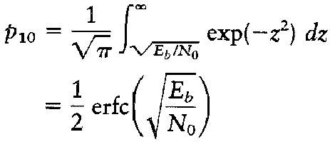
Error probability of BPSK
By letting
the above integral for $p10$ can be rewritten as

Slide 13
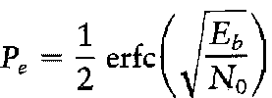
Error probability of error
In similar manner we can find probability of error that symbol 1 was sent and the receiver detect 0 mistakenly
The average probability as we did in the baseband can be computed as
This average probability is equivalent to the bit error rate

Slide 14
Generation of BPSK signals
To generate a binary PSK signal we need to present the binary sequence in polar form
The amplitude of logic 1 is $+\sqrt{E_{b}}$ whereas the amplitude of logic 0 is $−\sqrt{E_{b}}$
This signal transmission encoding is performed by using polar NRZ encoder

Slide 15
Generation of BPSK signals
The resulting binary wave and the carrier (basis function) are applied to product modulator as shown below

Slide 16
Detection of BPSK signals
To detect the original binary sequence we apply the received noisy PSK signal $x(t)=s (t)+n(t)$to a correlator followed by a decision device as shown below
The correlator works a matched filter

Slide 17
Power spectra of binary PSK signals
The power spectral density of the binary PSK signal can be found as described for the bipolar NRZ signaling (see problem 3.11 (a) Haykin)
This assumption is valid because the BPSK is generated by using bipolar NRZ signaling

Slide 18
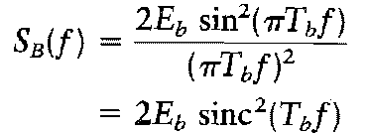
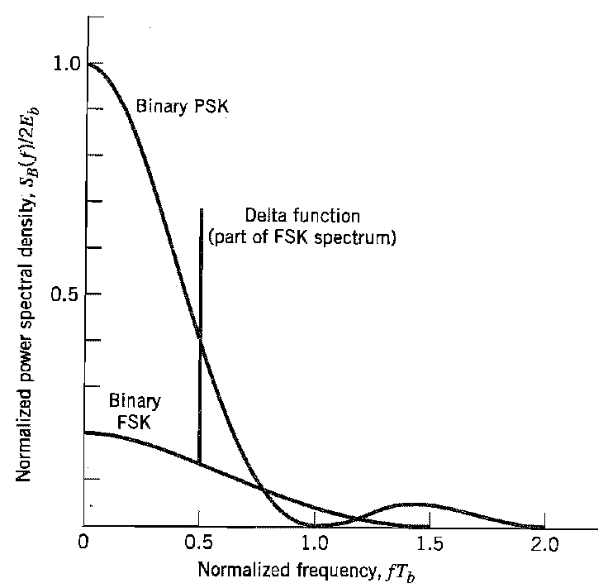
Power spectra of binary PSK signals
The power spectral density can be found as

Slide 19
Quadrature phase shift keying QPSK
In quadrature phase shift keying 4 symbols are sent as indicated by the equation
$$s_{i}\left(t\right)=\left\{\begin{matrix}\sqrt{\frac{2E}{T}}cos\left[2πf_{c}t+\left(2i−1\right)\frac{π}{4}\right] & 0≤t≤T \\ 0 & elsewhere\end{matrix}\right\}$$
Where $i=1, 2, 3, 4$; $E$ is the transmitted signal energy per symbol, and $T$ is the symbol duration
The carrier frequency is $\frac{n_{c}}{T}$ for some fixed integer $n_{c}$

Slide 20
Signal space diagram of QPSK
If we expand the QPSK equation using the trigonometric identities we got the following equation
Which we can write in vector format as

Slide 21
Signal space diagram of QPSK
There are four message points defined by
According to this equation , a QPSK has a two-dimensional signal constellation (i.e. $N=2$ or two basis functions)

Slide 22
Detailed message points for QPSK
i | Input Dibit | Phase of QPSK signaling | Coordinate of Message point
 |  |  | s_{i1} | s_{i2}
1 | 10
2 | 00
3 | 01
4 | 11

Slide 23
Signal space diagram of QPSK
φ₂
s₃
s₄
(01)
(11)
φ₁
s₂
s₁
(00)
(10)

Slide 24
Signal space diagram of QPSK with decision zones
The constellation diagram may appear as shown below
φ₂
Z₃
Z₄
(10)
s₃
s₄
(11)
φ₁
Z₁
s₂
Z₂
s₁
(10)
(00)

Slide 25
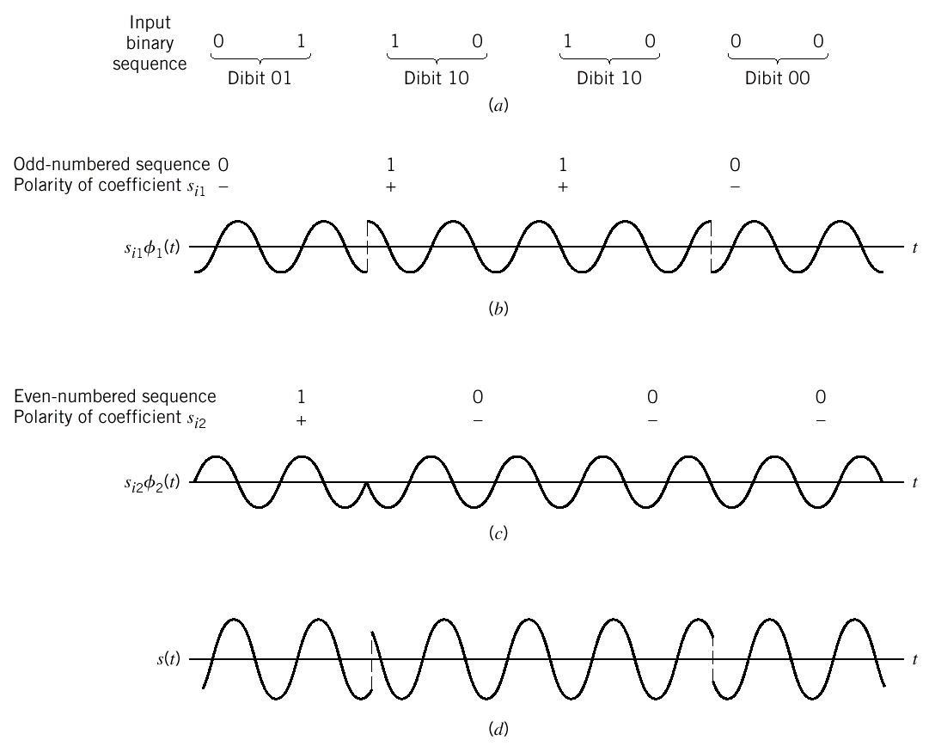
Example
Sketch the QPSK waveform resulting from the input binary sequence 01101000
solution

Slide 26
Error probability of QPSK
In coherent QPSK, the received signal $x\left(t\right)$ is defined by
$$\begin{matrix}x\left(t\right)=s_{i}\left(t\right)+w(t) & \left\{\begin{matrix}0≤t≤T \\ i=1, 2, 3, 4\end{matrix}\right\}\end{matrix}$$
Where $w(t)$ is the sample function of AWGN with zero mean and power spectral density of ${σ2}_{x}=\frac{N_{0}}{2}$

Slide 27
Error probability of QPSK
The observation vector $x$ has two elements, $x_{1}$ and $x_{2}$ defined by
$$x_{1}=\int_{0}^{T}{x\left(t\right)φ_{1}\left(t\right)dt}$$
$$x_{1}=\sqrt{E}cos\left[(2i−1)\frac{π}{4}\right]+w_{1}$$
$$x_{1}=±\sqrt{\frac{E}{2}}+w_{1}$$

Slide 28
Error probability of QPSK
$$x_{2}=\int_{0}^{T}{x\left(t\right)φ_{2}\left(t\right)dt}$$
$$x_{2}=\sqrt{E}sin\left[(2i−1)\frac{π}{4}\right]+w_{2}$$
$$x_{2}=∓\sqrt{\frac{E}{2}}+w_{2}$$

Slide 29
Error probability decision rule
If the received signal point associated with the observation vector $x$ falls inside region $Z1$, the receiver decide that $s1(t)$ was transmitted
Similarly the receiver decides that $s2(t)$ was transmitted if $x$ falls in region $Z2$
The same rule is applied for $s3(t)$ and $s4(t)$

Slide 30
Error probability of QPSK
We can treat QPSK as the combination of 2 independent BPSK over the interval $T=2T_{b}$
since the first bit is transmitted by $ϕ_{1}$and the second bit is transmitted by $ϕ_{2}$
Probability of error for each channel is given by

Slide 31
Error probability of QPSK
If symbol is to be received correctly both bits must be received correctly
Hence, the average probability of correct decision is given by
Which gives the probability of errors equal to

Slide 32
Error probability of QPSK
Since one symbol of QPSK consists of two bits, we have E = 2E_{b}
The above probability is the error probability per symbol
With gray encoding the average probability of error per bit
Which is exactly the same as BPSK

Slide 33
Error probability of QPSK summery
We can state that a coherent QPSK system achieves the same average probability of bit error as a coherent PSK system for the same bit rate and the same $\frac{E_{b}}{N_{0}}$ but uses only half the channel bandwidth

Slide 34
Generation and detection of QPSK
Block diagrams of (a) QPSK transmitter and (b) coherent QPSK receiver.

Slide 35
Power spectra of QPSK

Slide 36
OFFSET QPSK
90 degree shift in phase
φ₂
(01)
s₃
s₄
(11)
φ₁
s₂
s₁
(00)
(10)
180 degree shift in phase

Slide 37
OFFSET QPSK
Whenever both bits are changed simultaneously, 180 degree phase-shift occurs.
At 180 phase-shift, the amplitude of the transmitted signal changes very rapidly costing amplitude fluctuation.
This signal may be distorted when is passed through the filter or nonlinear amplifier.

Slide 38
OFFSET QPSK
Original Signal
Filtered signal

Slide 39
OFFSET QPSK
To solve the amplitude fluctuation problem, we propose the offset QPSK.
Offset QPSK delay the data in quadrature component by T/2 seconds (half of symbol).
Now, no way that both bits can change at the same time.

Slide 40
OFFSET QPSK
In the offset QPSK, the phase of the signal can change by ±90 or 0 degree only while in the QPSK the phase of the signal can change by ±180 ±90 or 0 degree.

Slide 41
OFFSET QPSK
Inphase
QPSK
0
1
1
0
Q phase
QPSK
1
0
0
0
QPSK
01
10
10
00
Inphase
Offset QPSK
0
1
1
0
Q phase
Offset QPSK
1
0
0
Offset QPSK
10
10
01
00

Slide 42
Offset QPSK
Possible paths for switching between the
message points in (a) QPSK and (b) offset QPSK.

Slide 43
OFFSET QPSK
Bandwidths of the offset QPSK and the regular QPSK is the same.
From signal constellation we have that
Which is exactly the same as the regular QPSK.

Slide 44
π/4-shifted QPSK
Try to reduce amplitude fluctuation by switching between 2 signal constellation

Slide 45
π/4-shifted QPSK
As the result, the phase of the signal can be changed in order of ±π/4 or ±3π/4

Slide 46
π/4-shifted QPSK
Since the phase of the next will be varied in order of ±π/4 and ±3π/4, we can designed the differential π/4-shifted QPSK as given below
Gray-Encoded Input Data | Phase Change in radians
00 | +π/4
01 | +3π/4
11 | -3π/4
10 | -π/4

Slide 47
π/4-shifted QPSK:00101001
Step | Initial phase | Input Dibit | Phase change | Transmitted phase
1 | π/4 | 00 | π/4 | π/2
2 | π/2 | 10 | -π/4 | π/4
3 | π/4 | 10 | -π/4 | 0
4 | 0 | 01 | 3π/4 | 3π/4

Slide 48
π/4-shifted QPSK
01
10
10
01

Slide 49
π/4-shifted QPSK
Since we only measure the phase different between adjacent symbols, no phase information is necessary. Hence, non-coherent receiver can be used.

Slide 50
Block diagram of the π/4-shifted DQPSK detector.

Slide 51
π/4-shifted QPSK
Illustrating the possibility of phase angles wrapping around the positive real axis.

Slide 52
M-array PSK
At a moment, there are M possible symbol values being sent for M different phase values,

Slide 53
M-array PSK
Signal-space diagram for octa phase-shift keying (i.e., M = 8). The decision boundaries are shown as dashed lines.
Signal-space diagram illustrating the application of the union bound for octa phase shift keying.

Slide 54
M-array PSK
Probability of errors

Slide 55
M-ary PSK

Slide 56
M-array PSK
Power Spectra (M-array)
M=2, we have

Slide 57
M-array PSK
Power spectra of M-ary PSK signals for M = 2, 4, 8.
T_{b}f

Slide 58
M-array PSK
Bandwidth efficiency:
We only consider the bandwidth of the main lobe (or null-to-null bandwidth)
Bandwidth efficiency of M-ary PSK is given by

Slide 59
M-ary QAM
QAM = Quadrature Amplitude Modulation
Both Amplitude and phase of carrier change according to the transmitted symbol, m_{i}
where a_{i} and b_{i} are integers, E0 is the energy of the signal with the lowest amplitude

Slide 60
M-ary QAM
Again, we have
as the basis functions
There are two QAM constellations, square constellation and rectangular

Slide 61
M-ary QAM
QAM square Constellation
Having even number of bits per symbol, denoted by 2n
M=L x L possible values
Denoting

Slide 62
16-QAM

Slide 63
L-ary, 4-PAM
16-QAM

Slide 64
16-QAM
Calculation of Probability of errors
Since both basis functions are orthogonal, we can treat the 16-QAM as combination of two 4-ary PAM systems.
For each system, the probability of error is given by

Slide 65
16-QAM
A symbol will be received correctly if data transmitted on both 4-ary PAM systems are received correctly. Hence, we have
Probability of symbol error is given by

Slide 66
16-QAM
Hence, we have
But because average energy is given by
We have

Slide 67
Coherent FSK
FSK = frequency shift keying
Coherent = receiver have information on where the zero phase of carrier.
We can treat it as non-linear modulation since information is put into the frequency.

Slide 68
Binary FSK
Transmitted signals are
where

Slide 69
Binary FSK
S₁(t) represented symbol “1”.
S₂(t) represented symbol “0”.
This FSK is also known as Sunde’s FSK.
It is continuous phase frequency-shift keying (CPFSK).

Slide 70
Binary FSK
There are two basis functions written as
As a result, the signal vectors are

Slide 72
BFSK
From the figure, we have
In case of Pr(0)=Pr(1), the probability of error is given by
We observe that at a given value of P_{e}, the BFSK system requires twice as much power as the BPSK system.

Slide 73
TRANSMITTER

Slide 74
RECEIVER

Slide 75
Power Spectral density of BFSK
Consider the Sunde’s FSK where f₁ and f₂ are different by 1/T_{b}. We can write
We observe that in-phase component does not depend on m_{i} since

Slide 76
Power Spectral density of BFSK
Half of the symbol power
We have
For the quadrature component

Slide 77
Power Spectral density of BFSK
Finally, we obtain

Slide 78
Phase Tree of BFSK
FSK signal is given by
At t = 0, we have
The phase of Signal is zero.

Slide 79
Phase Tree of BFSK
At t = T_{b}, we have
We observe that phase changes by ±π after one symbol (T_{b} seconds). -π for symbol “1” and +π for symbol “0”
We can draw the phase trellis as

Slide 81
Minimum-Shift keying (MSK)
MSK tries to shift the phase after one symbol to just half of Sunde’s FSK system. The transmitted signal is given by

Slide 82
MSK
Where
Observe that

Slide 83
MSK
h = T_{b}(f₁-f₂) is called “deviation ratio.”
For Sunde’s FSK, h = 1.
For MSK, h = 0.5.
h cannot be any smaller because the orthogonality between cos(2πf₁t) and cos(2πf₂t) is still held for h < 0.5.
Orthogonality guarantees that both signal will not interfere each other in detection process.

Slide 84
MSK
Phase trellis diagram for MSK signal 1101000

Slide 85
MSK
Signal s(t) of MSK can be decomposed into
where

Slide 86
MSK
Symbol | θ(0) | θ(T_{b})
1 | 0 | π/2
 | π | -π/2
0 | 0 | -π/2
 | π | π/2

Slide 87
MSK
For the interval –T_{b} < t ≤ 0, we have
Let’s note here that the ± for the interval -T_{b}<t≤ 0 and 0< t≤T_{b} may not be the same.
We know that

Slide 88
MSK
Since θ(0) can be either 0 or π depending on the past history. We have
“+” for θ(0) = 0 and “-” for θ(0) = π
Hence, we have

Slide 89
MSK
Similarly we can write
for 0< t≤T_{b} and T_{b} < t≤2T_{b}. Note the “+” and “-” may be different between these intervals.
Furthermore, we have that θ(T_{b}) can be ±π/2 depending on the past history.

Slide 90
MSK
Hence, we have
we have that θ(T_{b}) can be ±π/2 depending on the past history.

Slide 91
MSK
Hence, we have
“+” for θ(T_{b}) = +π/2 and “-” for θ(T_{b}) = -π/2
The basis functions change to

Slide 92
MSK
We write MSK signal as
Where and

Slide 93
MSK
Symbol | θ(0) | s₁ | θ(T_{b}) | s₂
1 | 0 |  | π/2
 | π |  | -π/2
0 | 0 |  | -π/2
 | π |  | π/2

Slide 94
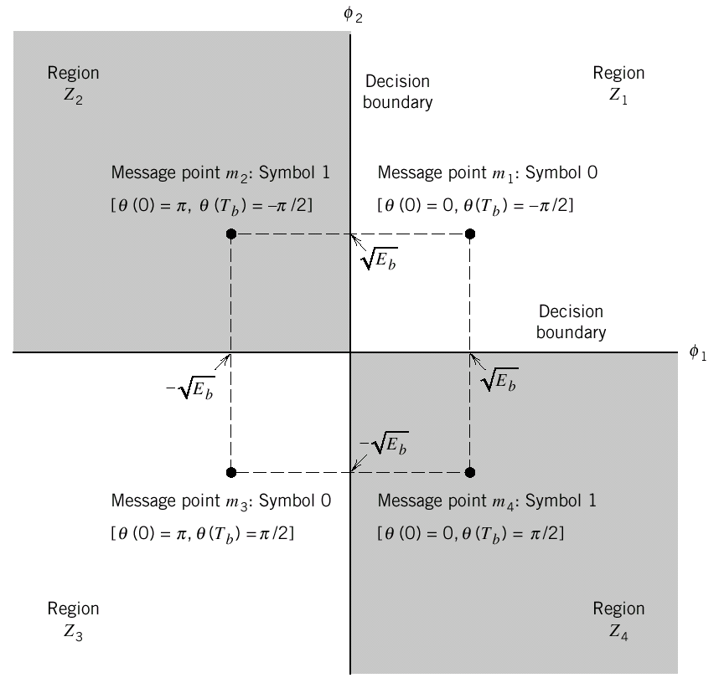

Slide 95
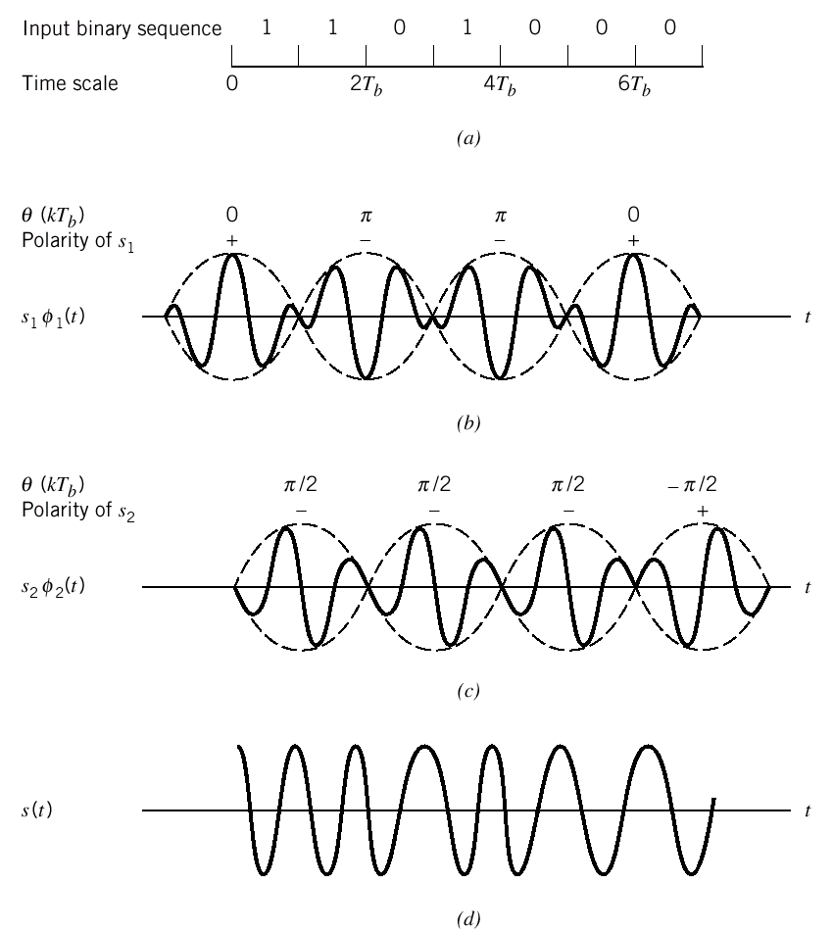
Phase:
0
π/2
π
π/2
π
π/2
0
-π/2

Slide 96
MSK
We observe that MSK is in fact the QPSK having the pulse shape
Block diagrams for transmitter and receiver are given in the next two slides.

Slide 100
MSK
Probability of error of MSK system is equal to BPSK and QPSK
This due to the fact that MSK observes the signal for two symbol intervals whereas FSK only observes for single signal interval.
Bandwidth of MSK system is 50% larger than QPSK.

Slide 101
Noncoherent Orthogonal Modulation
Noncoherent implies that phase information is not available to the receiver.
As a result, zero phase of the receiver can mean any phase of the transmitter.
Any modulation techniques that transmits information through the phase cannot be used in noncoherent receivers.

Slide 102
Noncoherent Orthogonal Modulation
sin(2πft)
sin(2πft)
cos(2πft)
cos(2πft)
Receiver
Transmitter

Slide 103
Noncoherent Orthogonal Modulation
It is impossible to draw the signal constellation since we do not know where the axes are.
However, we can still determine the distance of the each signal constellation from the origin.
As a result, the modulation techniques that put information in the amplitude can be detected.
FSK uses the amplitude of signals in two different frequencies. Hence non-coherent receivers can be employed.

Slide 104
Noncoherent Orthogonal Modulation
Consider the BFSK system where two frequencies f₁ and f₂ are used to represented two “1” and “0”.
The transmitted signal is given by
Problem is that θ is unknown to the receiver. For the coherent receiver, θ is precisely known by receiver.

Slide 105
Noncoherent Orthogonal Modulation
Furthermore, we have
To get rid of the phase information (θ), we use the amplitude

Slide 106
Noncoherent Orthogonal Modulation
Where
The amplitude of the received signal

Slide 107
Quadrature Receiver using correlators

Slide 108
Quadrature Receiver using Matched Filter

Slide 109
Noncoherent Orthogonal Modulation
Decision rule: Let if l_{i} > l_{k} for all k. For examples, decide if l₁ > l₂
This decision rule suggests that if the envelop (amplitude) of the received signal described in term of cos(2πf₁t) is greater than the envelop of the received signal described in term of cos(2πf₂t), we say s₁(t) was sent.

Slide 110
Noncoherent Matched Filter

Slide 111
Noncoherent Orthogonal Modulation
Consider the output of matched filter of cos(2πf_{i}t).

Slide 112
Noncoherent Orthogonal Modulation
Envelope at t=T is
Which is exactly the same as in correlator receiver

Slide 113
Generalized binary receiver for noncoherent orthogonal modulation.

Slide 114
Quadrature receiver equivalent to either one of the two matched filters in part

Slide 115
Noncoherent Orthogonal Modulation
Probability of Errors

Slide 116
Noncoherent: BFSK
For BFSK, we have

Slide 117
Noncoherent: BFSK

Slide 118
Noncoherent: BFSK
Probability of Errors

Slide 119
DPSK
Differential PSK
Instead of finding the phase of the signal on the interval 0<t≤T_{b.} This receiver determines the phase difference between adjacent time intervals.
If “1” is sent, the phase will remain the same
If “0” is sent, the phase will change 180 degree.

Slide 120
DPSK
Or we have
and

Slide 121
DPSK
In this case, we have T=2T_{b} and E=2E_{b}
Hence, the probability of error is given by

Slide 122
DPSK: Transmitter

Slide 123
DPSK
{b_{k}} |  | 1 | 0 | 0 | 1 | 0 | 0 | 0 | 1 | 1
{d_{k-1}} |  | 1 | 1 | 0 | 1 | 1 | 0 | 1 | 0 | 0
Differential encoded {d_{k}} | 1 | 1 | 0 | 1 | 1 | 0 | 1 | 0 | 0 | 0
Transmitted Phase | 0 | 0 | π | 0 | 0 | π | 0 | π | π | π

Slide 124
DPSK: Receiver

Slide 125
DPSK: Receiver
From the block diagram, we have that the decision rule as
If the phase of signal is unchanged (send “1”) the sign (“+” or “-”) of both x_{i} and x_{Q} should not change. Hence, the l(x) should be positive.
If the phase of signal is unchanged (send “0”) the sign (“+” or “-1”) of both x_{i} and x_{Q} should change. Hence, the l(x) should be negative.

Slide 126
Signal-space diagram of received DPSK signal.

