Slide 1
Base band pulse transmission
In this chapter, the following topics may be covered
  The matched filter
  Calculation of the bit error rate due to the presence of channel noise
  Inter symbol interference
  Nyquist’s criteria for distortion less base band data transmission
  Correlative level coding

Slide 2
Base band pulse transmission
  Equalization
  The eye pattern

Slide 3
Introduction
When digital data are transmitted through the communication channel it will be disturbed by two different noise types
  Inter-Symbol interference (ISI) which results due to the overlap between the adjacent pulses (treated by equalization)
  The additive white Gaussian noise which can be treated by the use of the matched filter at the receiver input

Slide 4
Matched filter
The matched filter is the first element in the base band receiver
The matched filter is a linear time invariant system used to maximize the signal to noise energy of the received signal sample

Slide 5
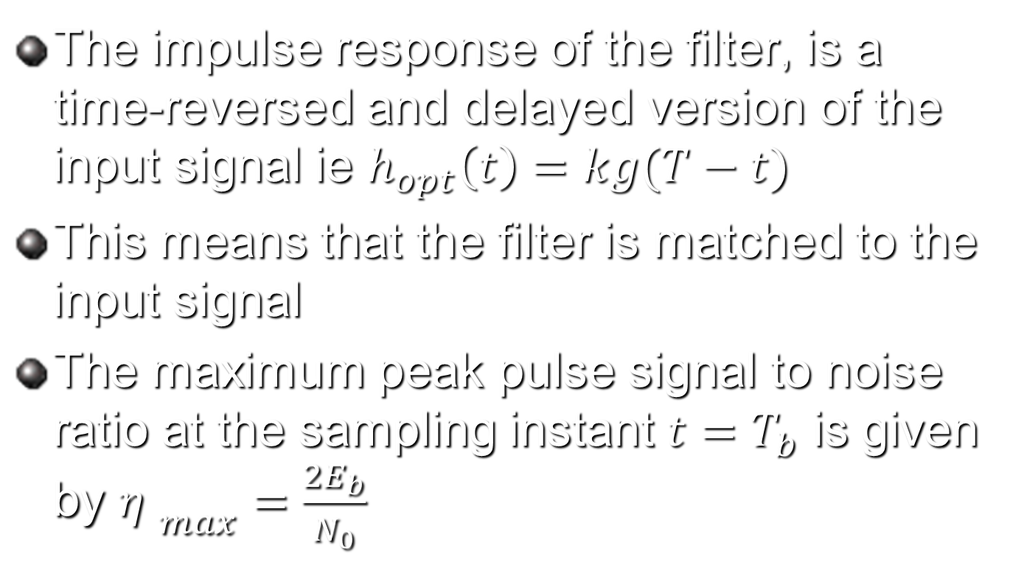
Impulse response of the optimum matched filter
The impulse response of the filter, is a time-reversed and delayed version of the input signal ie $h_{opt}\left(t\right)=kg(T−t)$
This means that the filter is matched to the input signal
The maximum peak pulse signal to noise ratio at the sampling instant $t=T_{b}$ is given by ${η }_{max}=\frac{2E_{b}}{N_{0}}$

Slide 6
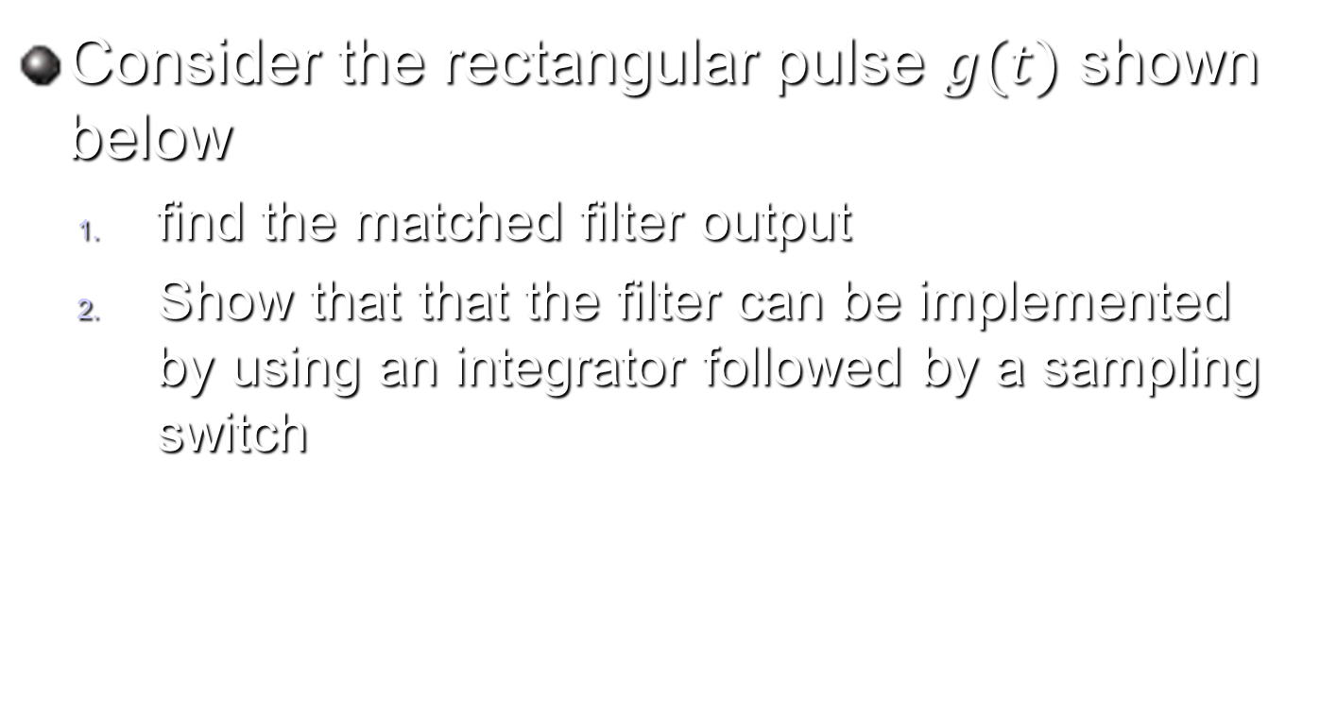
Example 4.1 Matched filter for rectangular pulse
Consider the rectangular pulse $g(t)$ shown below
  find the matched filter output
  Show that that the filter can be implemented by using an integrator followed by a sampling switch

Slide 7

Solution
The output signal is obtained by the convolution sum between g(t) and h(t)
The resulting filter output $g_{o}\left(t\right)$ is shown below

Slide 8
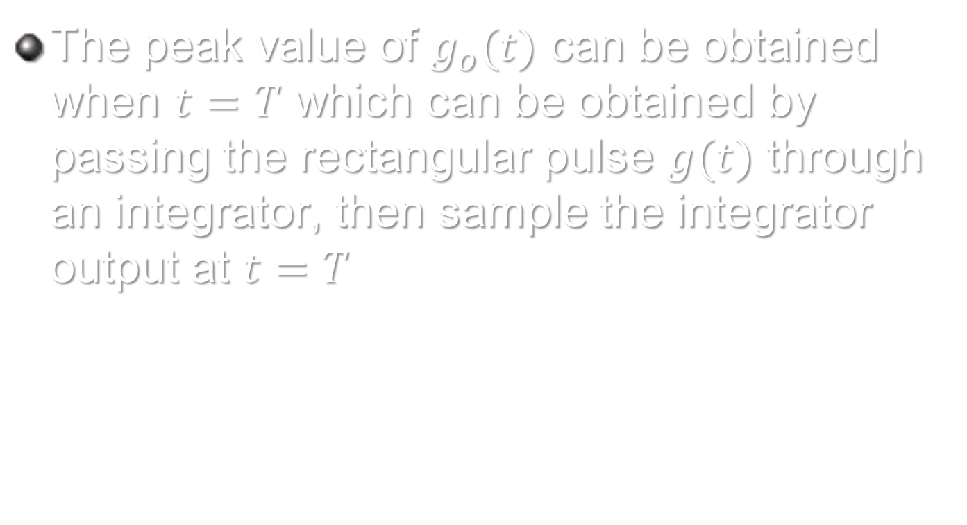
solution
The peak value of $g_{o}(t)$ can be obtained when $t=T$ which can be obtained by passing the rectangular pulse $g(t)$ through an integrator, then sample the integrator output at $t=T$

Slide 9
Matched filter example

Slide 10
Solution

Slide 11
solution

