Slide 1
Delta modulation DM
DM is a simple modulation scheme used to transmit one bit per sampling frequency
In DM the analog information signal is oversampled purposely to increase the correlation between adjacent samples
This is done to permit the use of a simple quantization strategy for the construction of the encoded signal

Slide 2
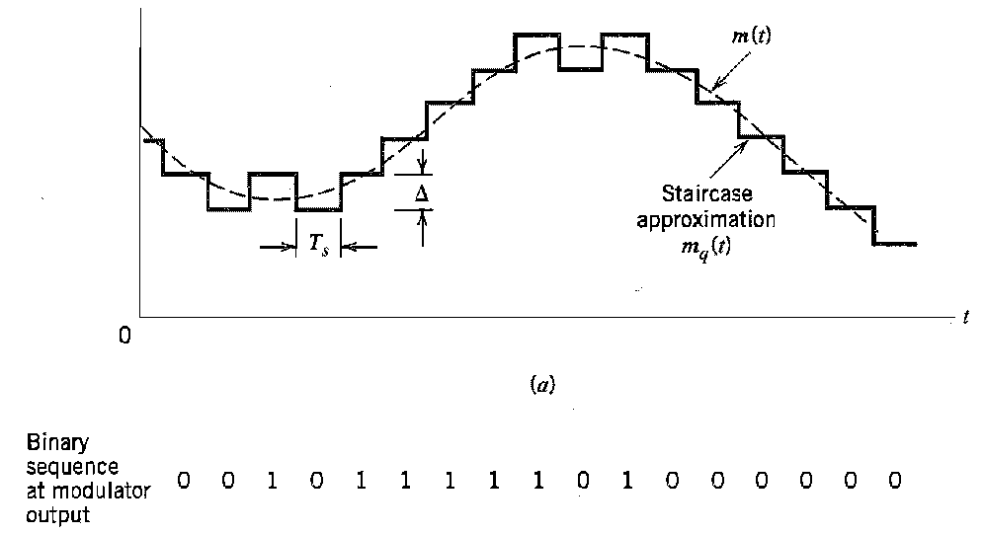
DM principle of operation
In its basic form, DM provides a stair case approximation to the oversampled version of the message signal as shown

Slide 3
DM principle of operation
The difference between the input signal sample and the stair case approximation is quantized into only to two levels
If the current sample is greater than the previous sample then the DM modulator generates
If the current sample falls below the previous sample then the modulator generates

Slide 4
DM discrete-time equations
The discrete time equations which describes delta modulation are

Slide 5
DM discrete-time equations
Where e[n] is the error signal representing the difference between the present sample m[n] and the latest approximation m_{q}[n-1] to it
e_{q}[n] is the quantized version of the error

Slide 6
Main advantage of DM
The main advantage of DM is its simplicity

Slide 7
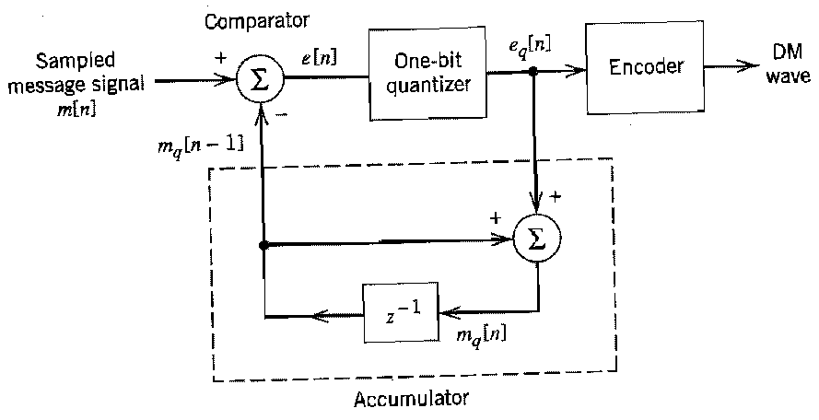
DM modulator
The delta modulator can be constructed from the discrete time equations according to the block diagram shown below

Slide 8
DM demodulator
The DM demodulator do the reverse operation of the modulator to reconstruct the original signal
This can be achieved by summing the received bit stream as described by the following equation

Slide 9
DM demodulator
The waveform results at the receiver contains a stair-case approximation
The stair approximation corresponds to the presence of high frequency distortion presented in the message signal
The high frequency distortion can be removed by using a LPF

Slide 10
DM demodulator
The DM demodulator can be constructed from the discrete time equations describing the demodulator according block diagram shown below

Slide 11
Quantization errors in delta modulation
Delta modulation is subjected into two quantization error distortions
Slope overload distortion
Granular noise

Slide 12
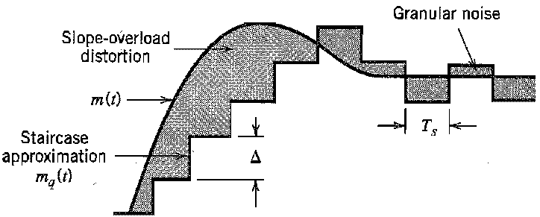
Slope overload distortion
Slope overload distortion occurs when the step size is too small for the stair case approximation to follow a steep segment of the message signal m(t)

Slide 13
Slope overload distortion
Slope over load distortion can be avoided if the step size ∆ is selected according to the following equation

Slide 14
Granular noise distortion
Granular noise occurs when the step size ∆ is too large relative to the local slope characteristics of the input signal
This would cause the stair case approximation m_{q}(t) to hunt around a relatively flat segment of the input waveform

Slide 15
Disadvantage of DM
The main disadvantage of the DM scheme is the presence of an accumulative error in the demodulated signal
This problem can be solved by using a delta-sigma modulator

Slide 16
Delta-sigma modulation
In the delta sigma modulator the input signal, m(t), will be integrated prior to delta modulation
The use of integration in the manner described here has the following beneficial effects
The low frequency content of the input signal is pre-emphasized

Slide 17
Delta sigma modulation
Correlation between adjacent samples of the delta modulator input is increased, which tends to improve the overall system performance by reducing the variance of the error signal at the quantizer input
Design of the receiver is simplified

Slide 18
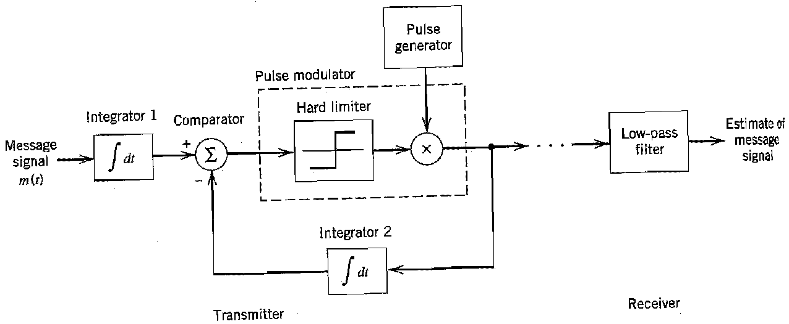
Delta sigma modulator block diagram
The block diagram of the delta sigma modulator is shown below

Slide 19
Delta sigma modulator block diagram
The previous block diagram can be greatly simplified if the signal is first differentiated then applied to the input of the integrator

Slide 20
DM examples

Slide 21
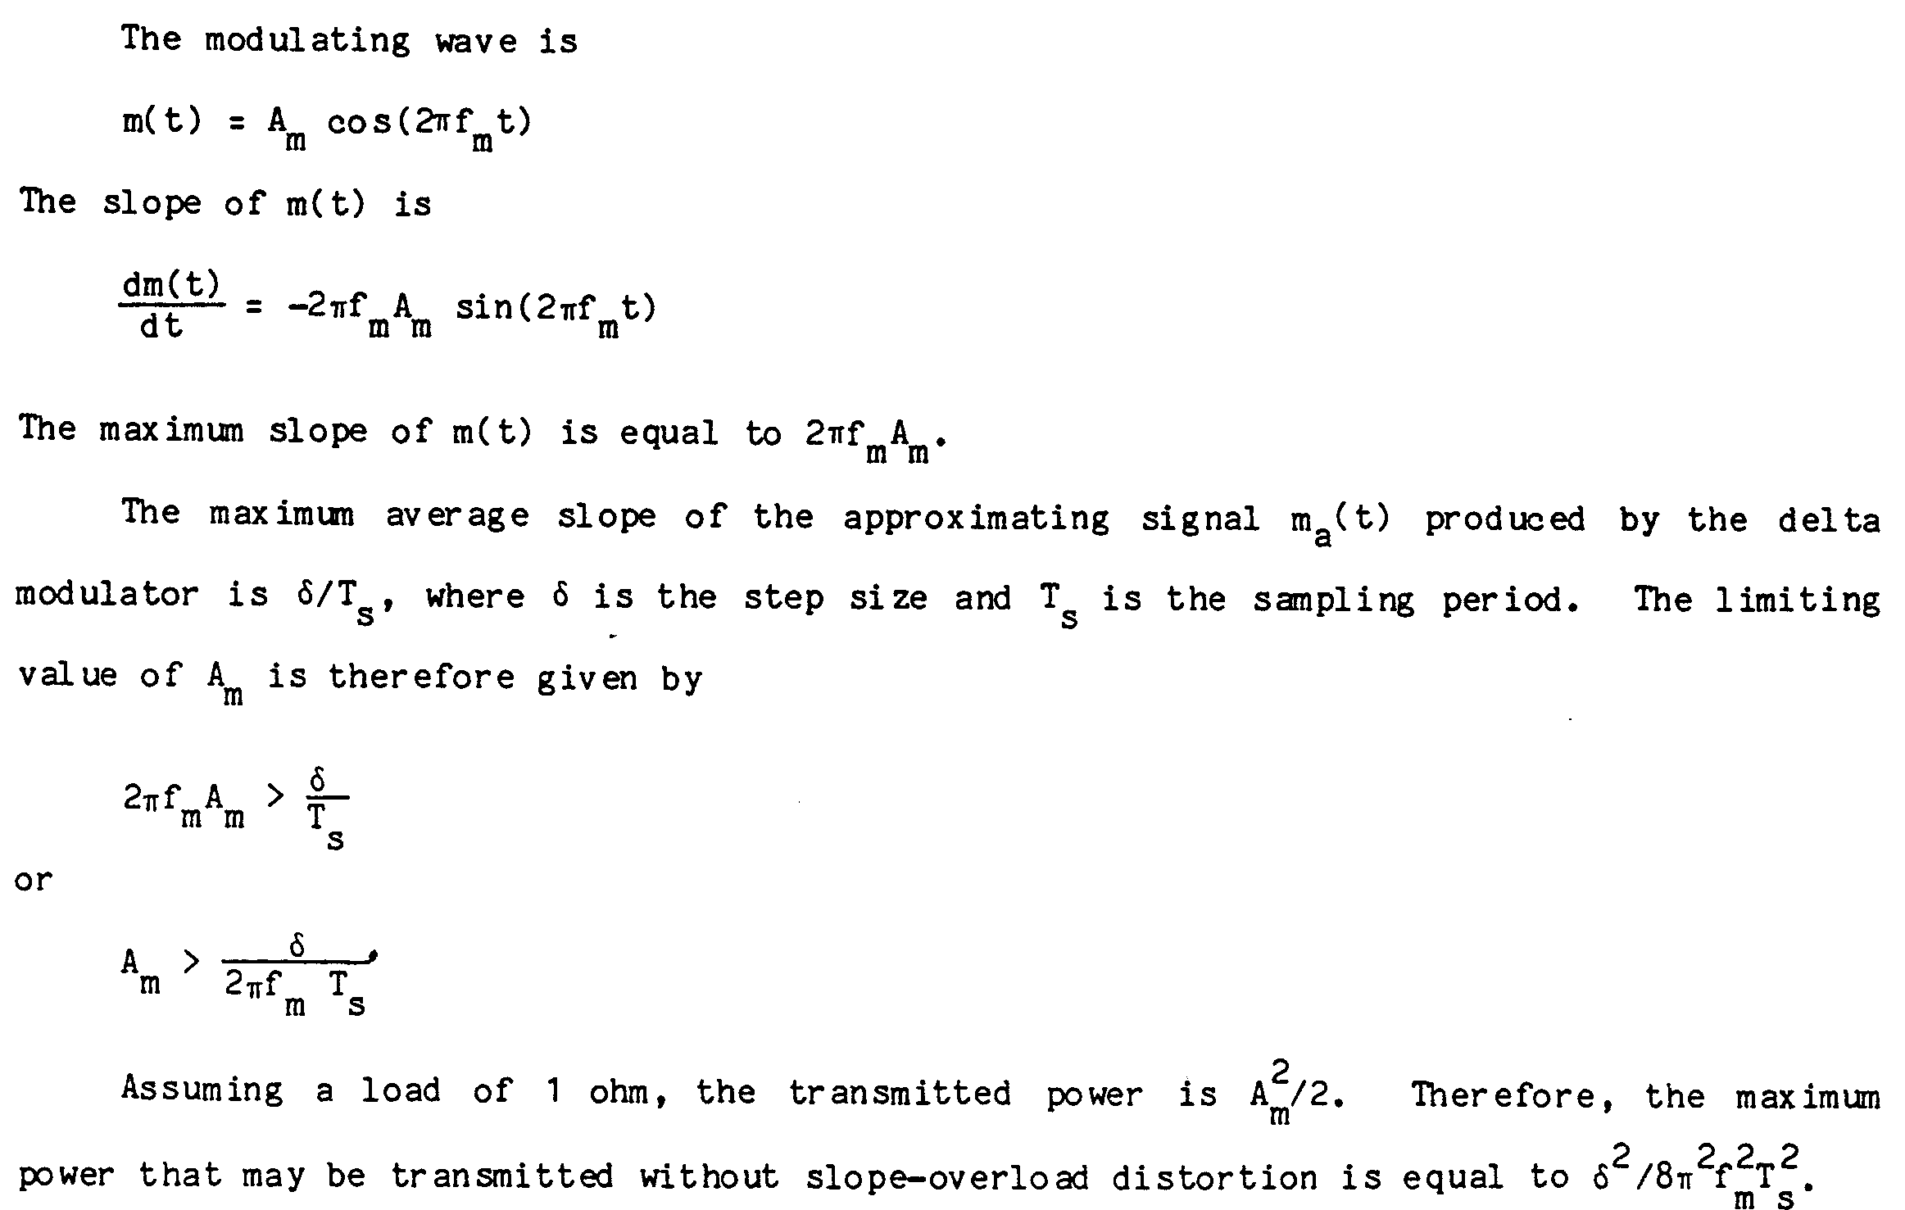
DM examples

Slide 22
DM examples

Slide 23
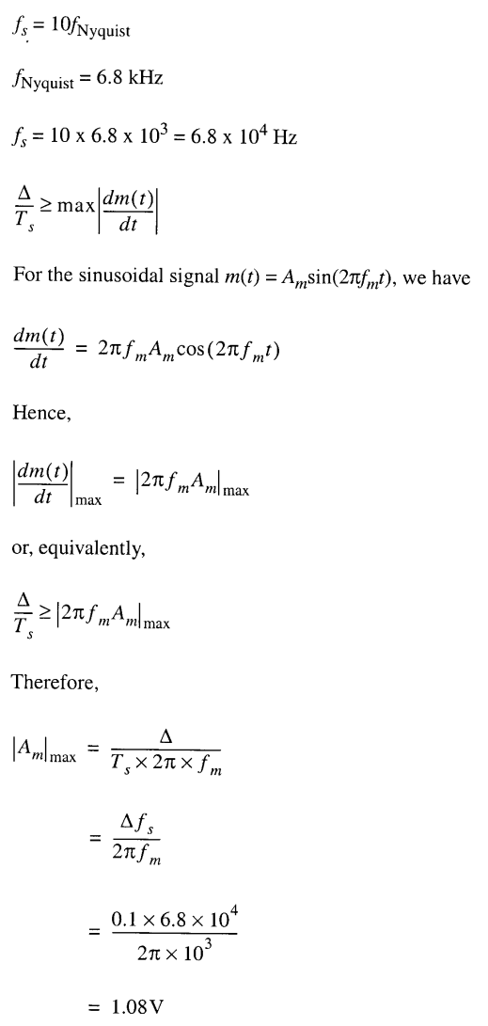
DM examples

