Slide 1
Error rate due to noise
In this section, an expression for the probability of error will be derived
The analysis technique, will be demonstrated on a binary PCM based on polar NRZ signaling
The channel noise is modeled as additive white Gaussian noise $w(t)$ of zero mean and power spectral density $\frac{N_{0}}{2}$

Slide 2
Bit error rate
The receiver of the communication system can be modeled as shown below
The signaling interval will be $0≤t≤T_{b}$, where $T_{b}$ is the bit duration
x(t)
y(t)
Y

Slide 3
Bit error rate
The received signal can be given by $x\left(t\right)=\left\{\begin{matrix}+A+w\left(t\right), & symbol 1 was sent \\ −A+w\left(t\right), & symbol 0 was sent\end{matrix}\right\}$
It is assumed that the receiver has acquired knowledge of the starting and ending times of each transmitted pulse
The receiver has a prior knowledge of the pulse shape, but not the pulse polarity

Slide 4
Receiver model
The structure of the receiver used to perform this decision making process is shown below

Slide 5
Possible errors
When the receiver detects a bit there are two possible kinds of error
Symbol 1 is chosen when a 0 was actually transmitted; we refer to this error as an error of the first kind
Symbol 0 is chosen when a 1 was actually transmitted; we refer to this error as an error of the second kind

Slide 6
Average probability of error calculations
To determine the average probability of error, each of the above two situations will be considered separately
If symbol 0 was sent then, the received signal is
$x\left(t\right)=−A+w\left(t\right), 0≤t≤T_{b}$

Slide 7
Average probability of error calculations
The matched filter output will be given by
$$y=\frac{1}{T_{b}}\int_{0}^{T_{b}}{x\left(t\right)dt}$$
$$y=−A+\frac{1}{T_{b}}\int_{0}^{T_{b}}{x\left(t\right)dt}=−A$$
The matched filter output represents a random variable $Y$

Slide 8
Average probability of error calculations
This random variable is a Gaussian distributed variable with a mean of $−A$
The variance of $Y$ is ${σ2}_{Y}^{}=\frac{N_{0}}{2T_{b}}$
The conditional probability density function the random variable $Y$, given that symbol 0 was sent, is therefore
$f_{Y}\left(y | 0\right)=\frac{1}{\sqrt{πN_{0}/T_{b}}}e^{\left(−\frac{{\left(y+A\right)}^{2}}{{N_{0}}/{T_{b}}}\right)}$

Slide 9
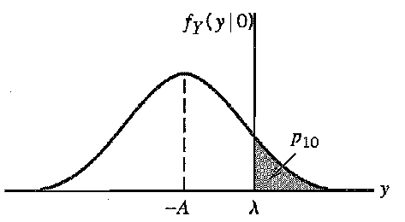
Average probability of error calculations
The probability density function is plotted as shown below
To compute the conditional probability, $p_{10}$, of error that symbol 0 was sent, we need to find the area between $λ$ and $∞$

Slide 10
In mathematical notations
$$p_{10}=P\left(y>λ\right|symbol 0 was sent$$
$$p_{10}=\int_{λ}^{∞}{f_{y}\left(y | 0\right)dy}$$
$$p_{10}=\frac{1}{\sqrt{πN_{0}/T_{b}}}\int_{λ}^{∞}{e^{\left(−\frac{\left(y+A\right)2}{N_{0}/T_{b}}\right)}dy}$$

Slide 11
The integral
$$erfc⁡(z)=\frac{2}{\sqrt{π}}\int_{λ}^{∞}{e^{\left(−z2\right)}dz}$$
Is known as the complementary error function which can be solved by numerical integration methods

Slide 12
By letting $z=\frac{y+A}{\sqrt{N_{0}/T_{b}}}$, $dy=\sqrt{N_{0}/T_{b}} dz$, $p10$ became
$$p_{10}=\frac{1}{\sqrt{π}}\int_{\left(\frac{A+λ}{\sqrt{N_{0}/T_{b}}}\right)}^{∞}{e^{−z2}}dz$$
$$p_{10}=\frac{1}{2}erfc\left(\frac{A+λ}{\sqrt{N_{0}/T_{b}}}\right)$$

Slide 13
By using the same procedure, if symbol 1 is transmitted, then the conditional probability density function of Y, given that symbol 1 was sent is given
$f_{Y}\left(y | 1\right)=\frac{1}{\sqrt{πN_{0}/T_{b}}}e^{\left(−\frac{{\left(y−A\right)}^{2}}{{N_{0}}/{T_{b}}}\right)}$
Which is plotted in the next slide

Slide 14
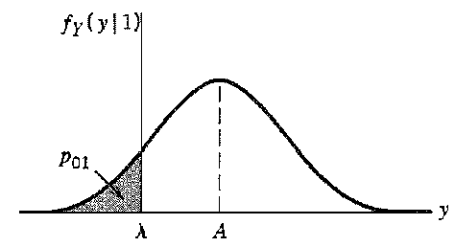
The probability density function $f(Y|1)$ is plotted as shown below

Slide 15
The probability of error that symbol 1 is sent and received bit is mistakenly read as 0 is given by
$$p_{01}=\int_{λ}^{∞}{f_{y}\left(y | 1\right)dy}$$
$$p_{10}=\frac{1}{\sqrt{πN_{0}/T_{b}}}\int_{λ}^{∞}{e^{\left(−\frac{\left(y−A\right)2}{N_{0}/T_{b}}\right)}dy}$$

Slide 16
Expression for the average probability of error
$$p_{10}=\frac{1}{2}erfc\left(\frac{A−λ}{\sqrt{N_{0}/T_{b}}}\right)$$
The average probability of error $P_{e}$is given by
$$P_{e}=P_{0}P_{10}+P_{1}P_{01}$$
$$P_{e}=\frac{P_{0}}{2}erfc\left(\frac{A+λ}{\sqrt{N_{0}/T_{b}}}\right)+\frac{P_{1}}{2}erfc\left(\frac{A−λ}{\sqrt{N_{0}/T_{b}}}\right)$$

Slide 17
In order to find the value of $λ$ which minimizes the average probability of error we need to derive $P_{e}$ with respect to $λ$ and then equate to zero as
$$\frac{∂P_{e}}{∂λ}=0$$
From math's point of view (Leibniz’s rule)
$$\frac{∂erfc⁡(u)}{∂u}=−\frac{1}{\sqrt{π}}e^{−u2}$$

Slide 18
Optimum value of the threshold $λ$ value
If we apply the previous rule to $P_{e}$, then we may have the following equations
$$\frac{∂P_{e}}{∂λ}=−\frac{1}{\sqrt{π{N_{0}}/{T_{b}}}}\frac{p_{0}}{2}e^{−\frac{({A+λ)}^{2}}{{N_{0}}/{T_{b}}}}+\frac{1}{\sqrt{π{N_{0}}/{T_{b}}}}\frac{p_{1}}{2}e^{−\frac{({A−λ)}^{2}}{{N_{0}}/{T_{b}}}}=0$$
By solving the previous equation we may have
$$\frac{p_{0}}{p_{1}}=\frac{e^{−\frac{({A−λ)}^{2}}{{N_{0}}/{T_{b}}}}}{e^{−\frac{({A+λ)}^{2}}{{N_{0}}/{T_{b}}}}}=\frac{f_{y}(y|1)}{f_{y}(y|0)}$$

Slide 19
From the previous equation, we may have the following expression for the optimum threshold point
$$λ_{opt}=\frac{N_{0}}{{4T}_{b}}ln\left(\frac{p_{0}}{p_{1}}\right)$$
If both symbols 0 and 1 occurs equally in the bit stream, then $p_{0}=p_{1}=\frac{1}{2}$, then
$λ_{opt}=0$

Slide 20
$P_{e}=\frac{1}{2}erfc\left(\frac{A}{\sqrt{N_{0}/T_{b}}}\right)$
$$=\frac{1}{2}erfc\left(\sqrt{\frac{A^{2}}{N_{0}/T_{b}}}\right)$$
$$=\frac{1}{2}erfc\left(\sqrt{\frac{A^{2}T_{b}}{N_{0}}}\right)$$
$$=\frac{1}{2}erfc\left(\sqrt{\frac{E_{b}}{N_{0}}}\right)$$

Slide 21
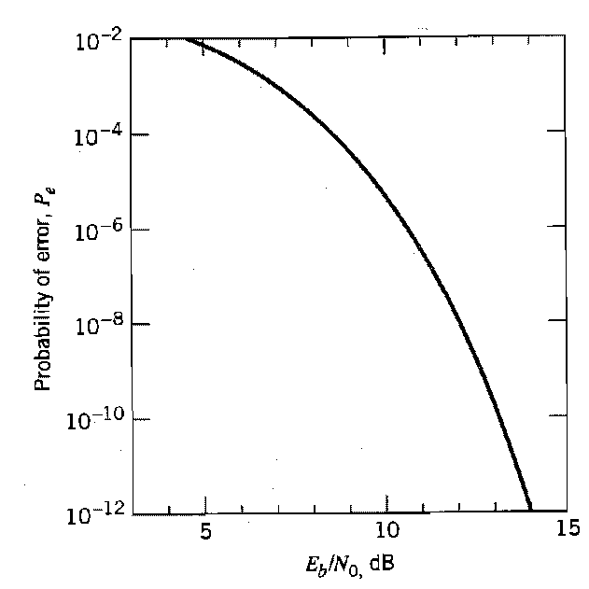
Average probability of error vs $\frac{E_{b}}{N_{0}}$
A plot of the average probability of error as a function of the signal to noise energy is shown below

Slide 22
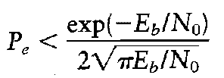
As it can be seen from the previous figure, the average probability of error decreases exponential as the signal to noise energy is increased
For large values of the signal to noise energy the complementary error function can be approximated as

Slide 23
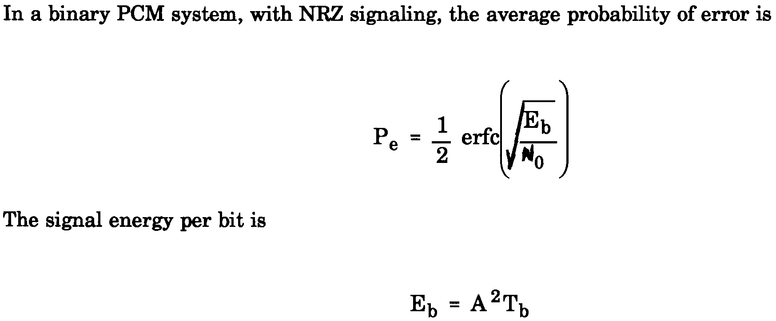
Example1
Solution

Slide 24
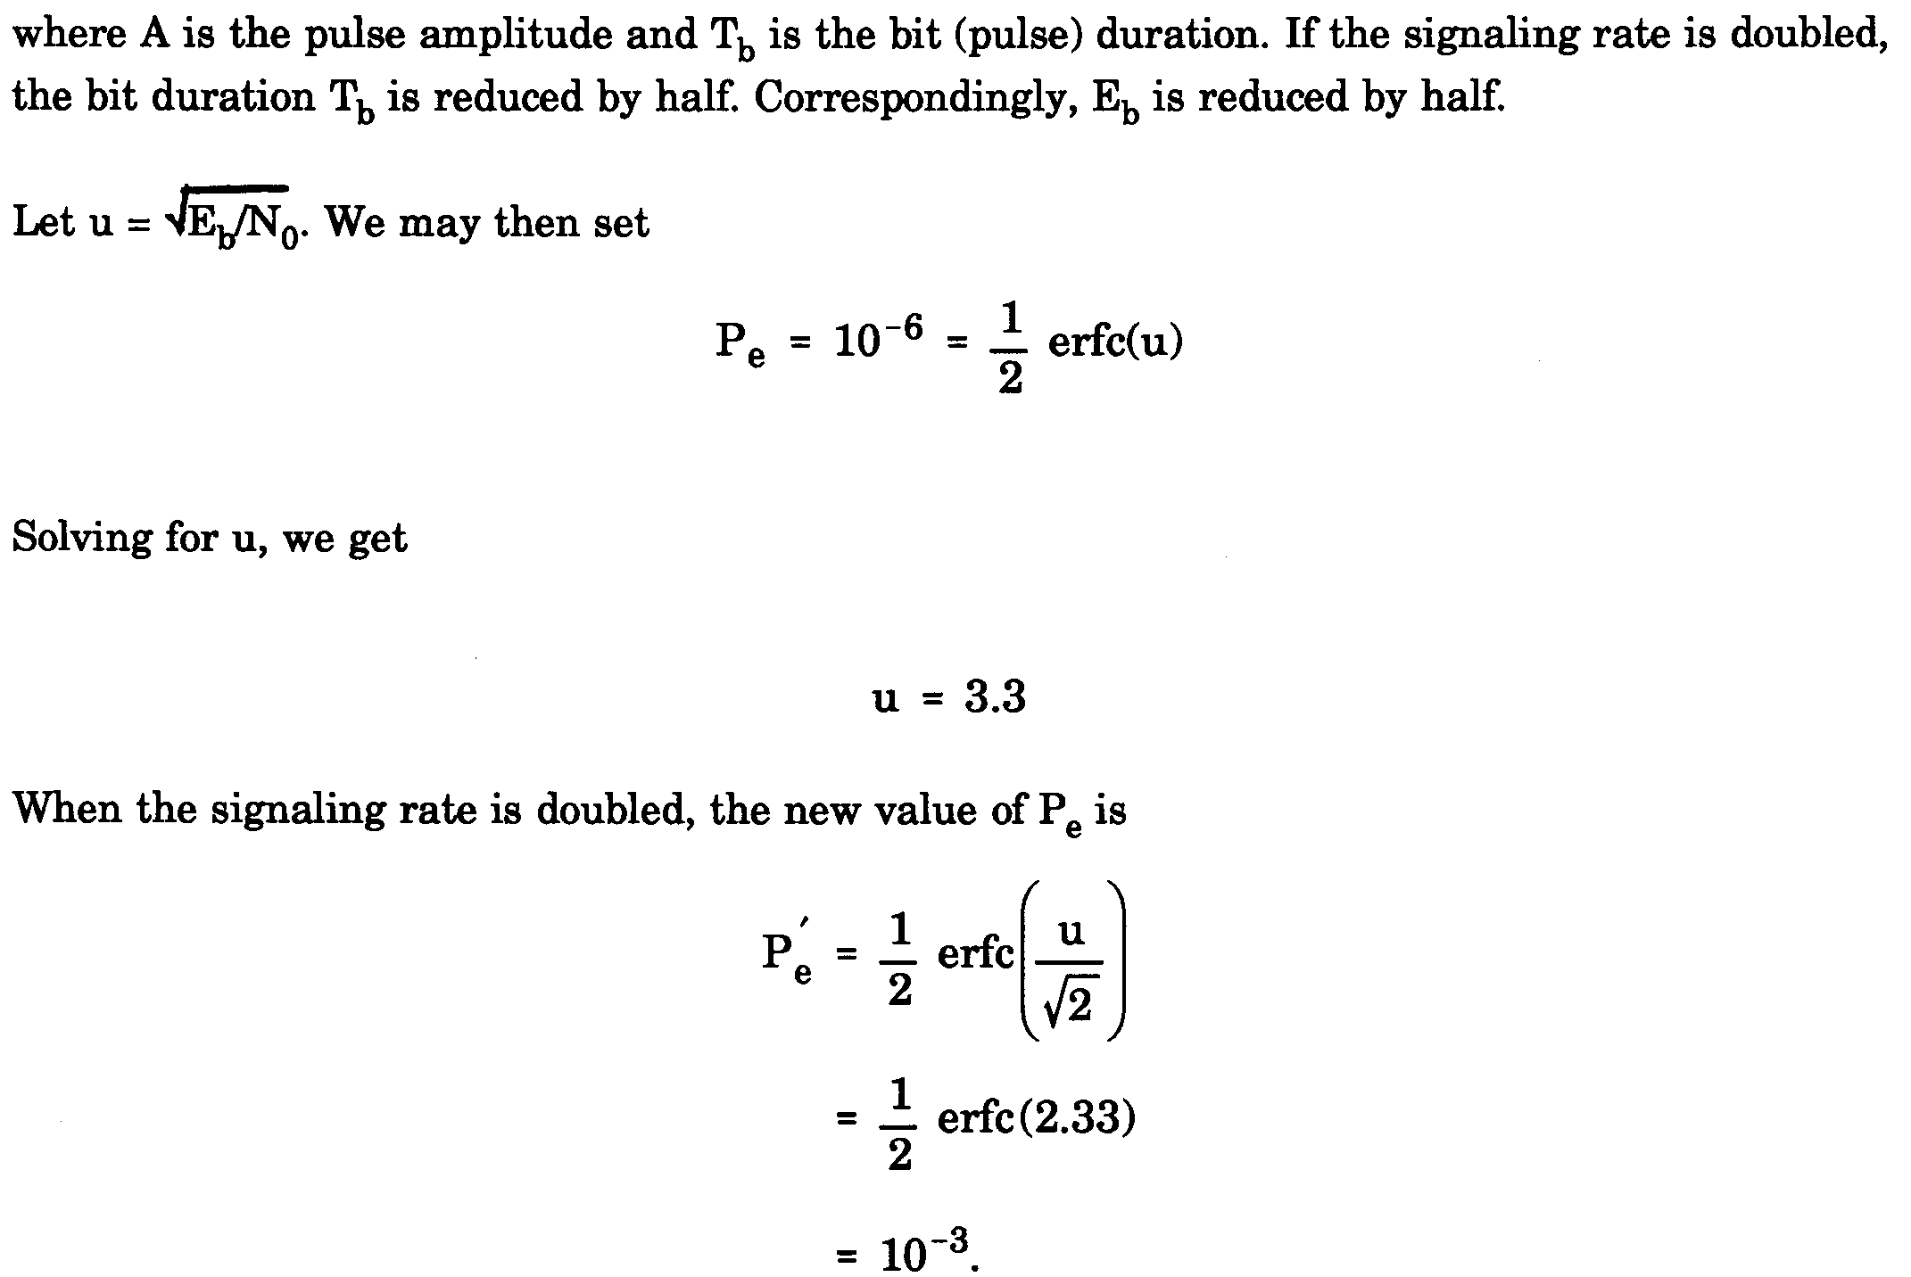
Example1 solution

Slide 25
Example 2

Slide 26
Example 2 solution
The average probability of error is given by $P_{e}=\frac{1}{2}\operatorname{erfc}\left(\sqrt{\frac{E_{b}}{N_{0}}}\right)$ where $E_{b}=A^{2}T_{b}$,
We can rewrite $P_{e}=\frac{1}{2}\operatorname{erfc}\left(\sqrt{\frac{A^{2}T_{b}}{N_{0}}}\right)=\frac{1}{2}\operatorname{erfc}\left(\sqrt{\frac{2A^{2}}{2\frac{N_{0}}{T_{b}}}}\right)=\frac{1}{2}\operatorname{erfc}\left(\frac{\sqrt{2}A}{σ}\right)$, where $σ=\sqrt{\frac{N_{0}}{2T_{b}}}$

Slide 27
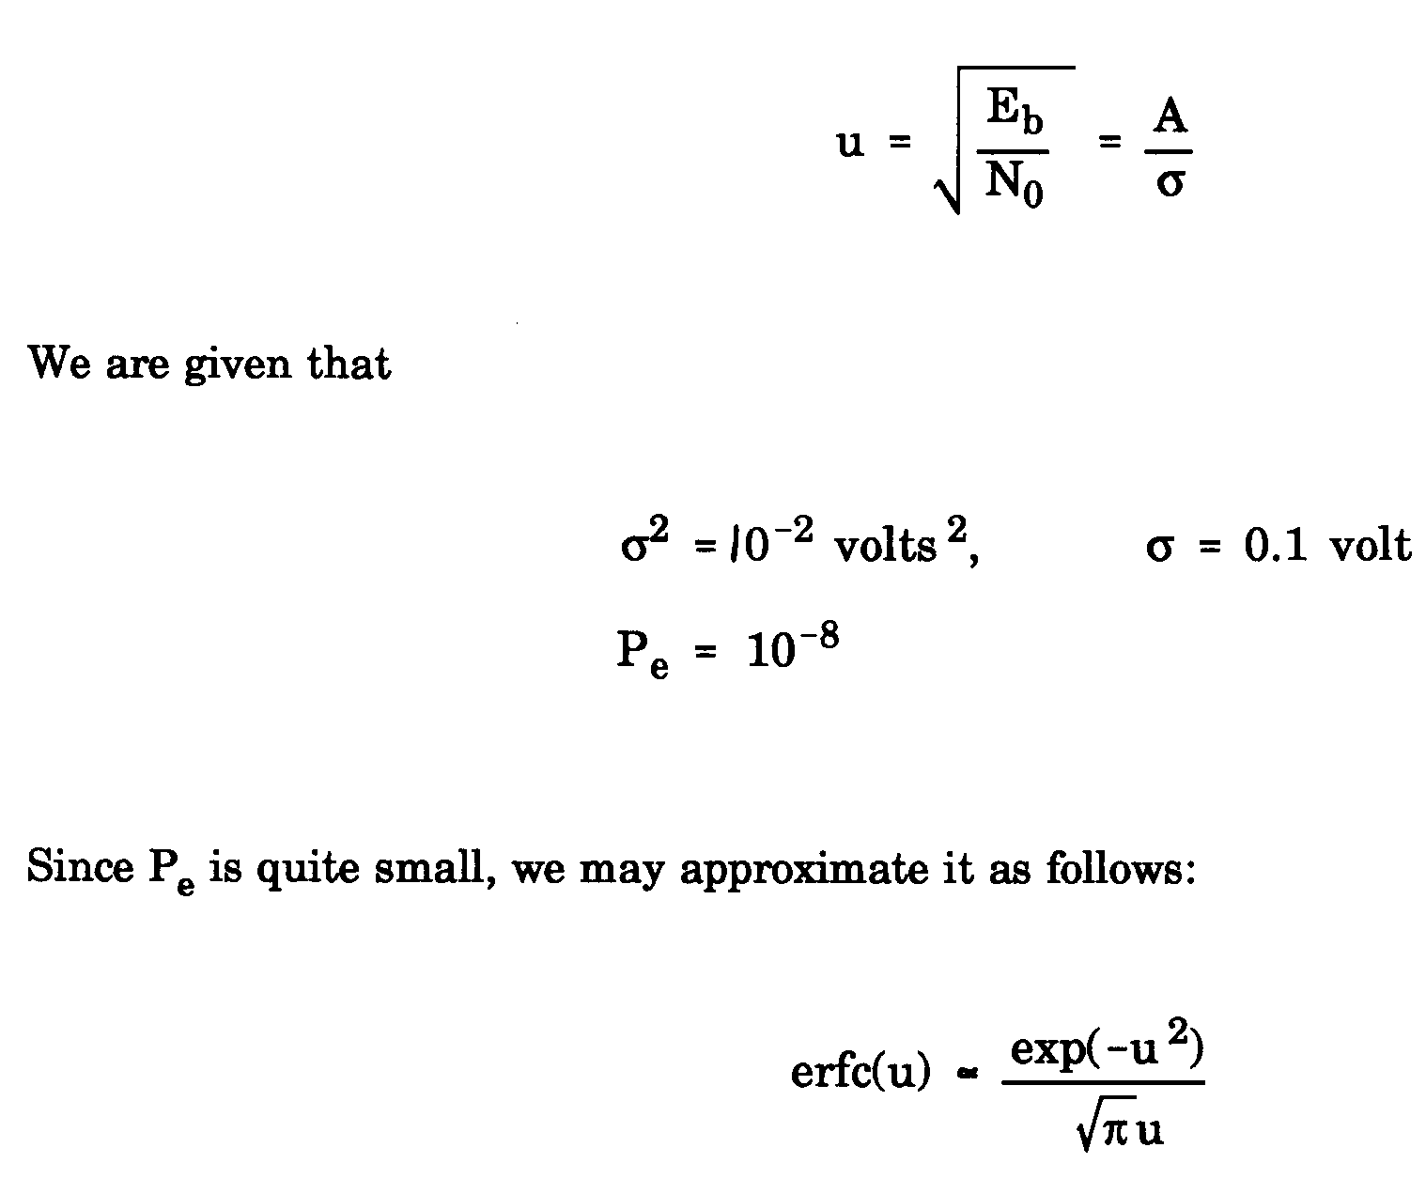
Example 2 solution

Slide 28
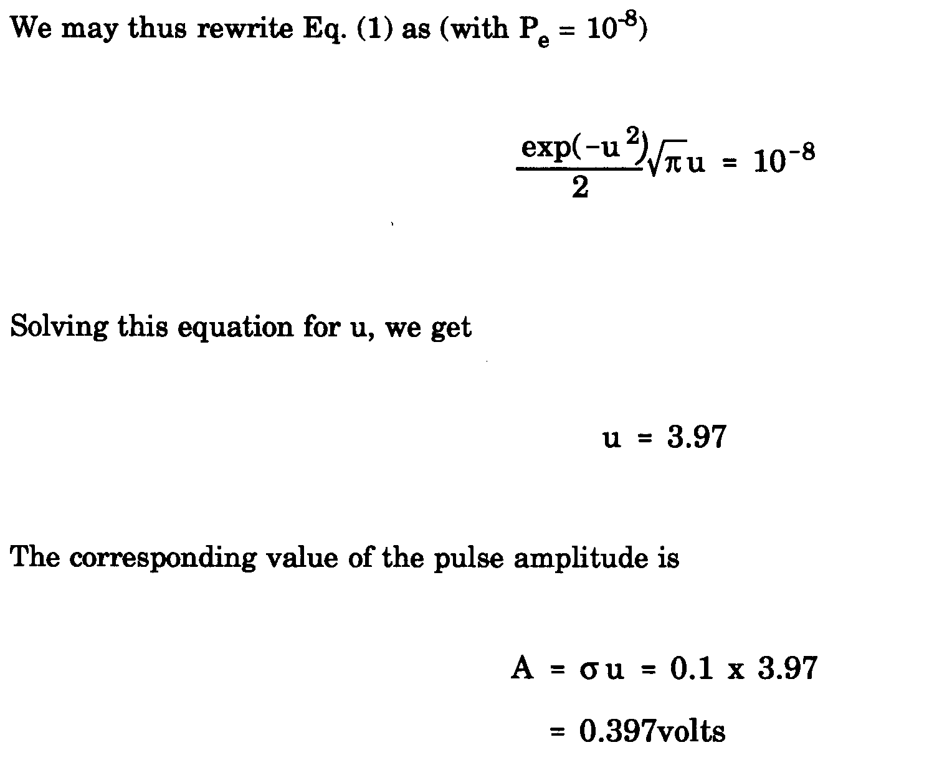
Example 2 Solution

Slide 29
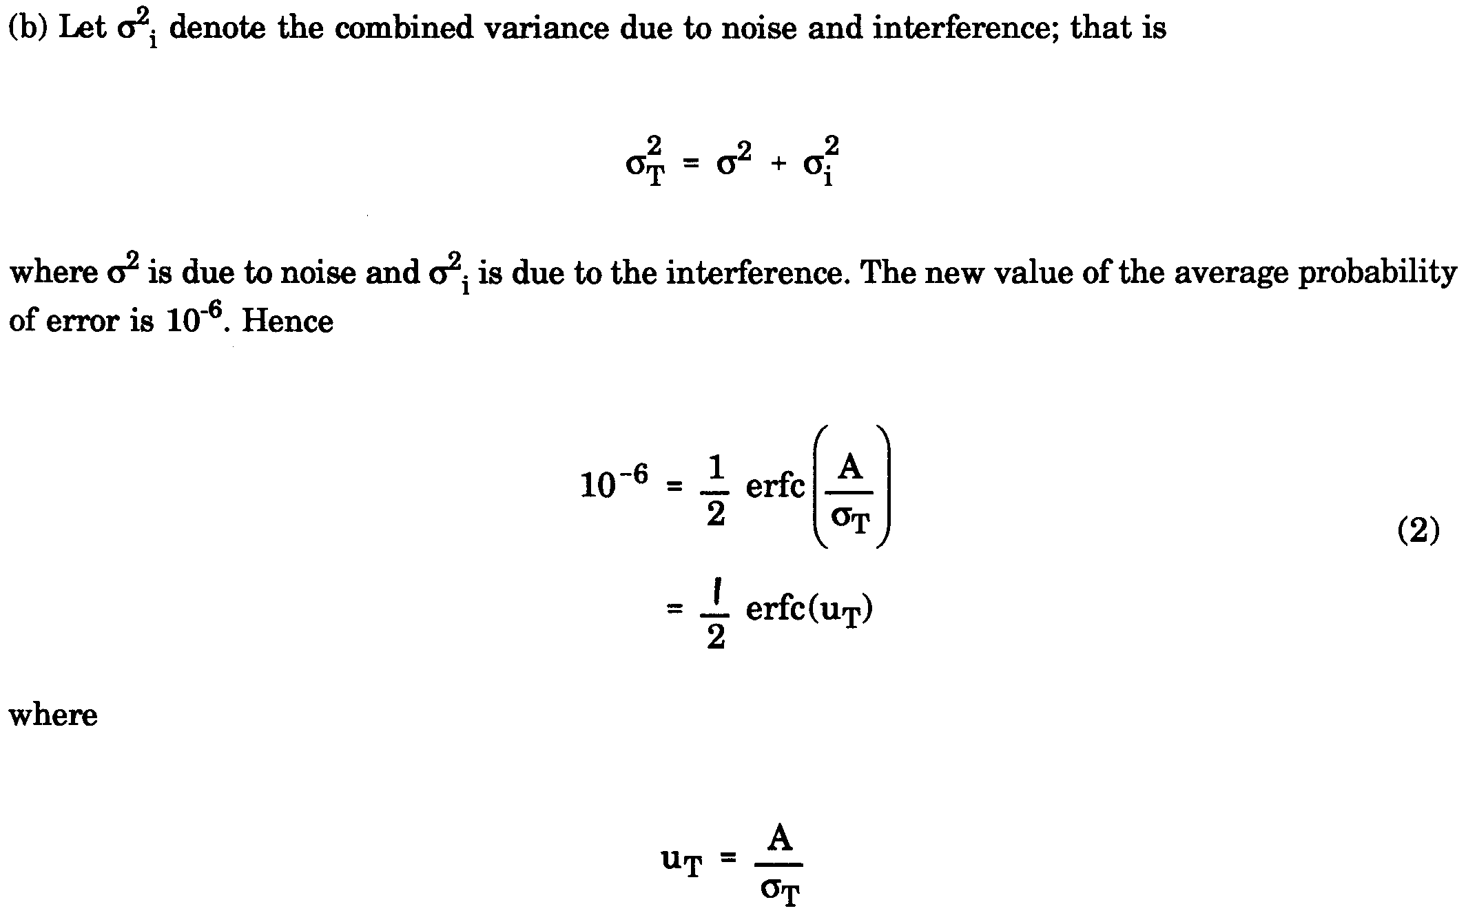
Example 2 solution

Slide 30
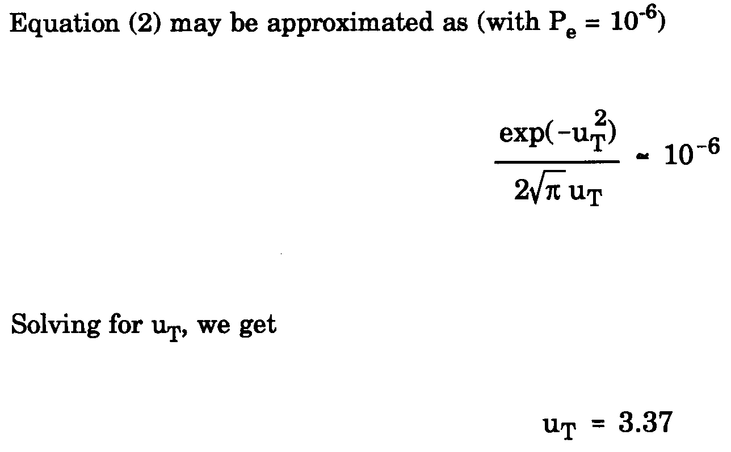
Example 2 solution

Slide 31
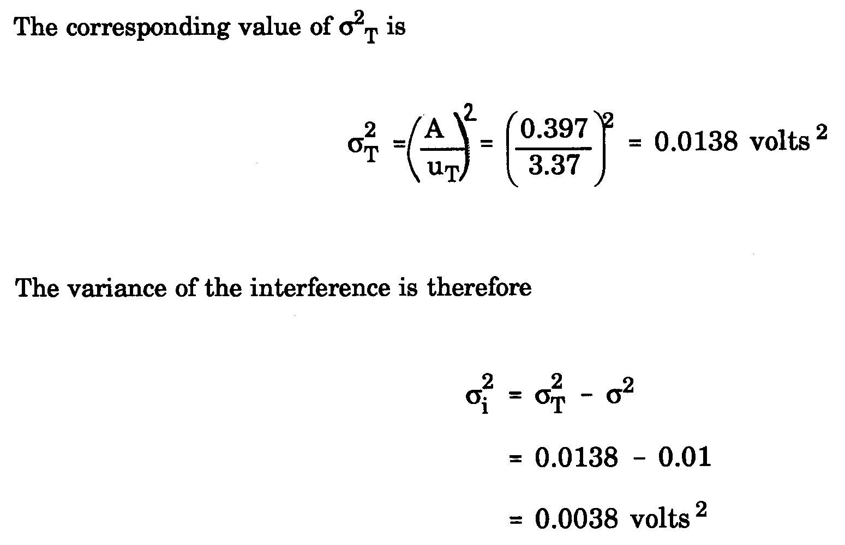
Example 2 solution

Slide 32
Example 3

Slide 33
Example 3 solution
Signaling with NRZ pulses represents an example of antipodal signaling, we can use
$$P_{e}=\frac{1}{2}erfc\left(\sqrt{\frac{E_{b}}{N_{0}}}\right)$$
$$1×{10}^{−3}=\frac{1}{2}erfc\left(\sqrt{\frac{A^{2}(\frac{1}{56000})}{{10}^{−6}}}\right)$$

Slide 34
Example 3 solution
Using the $erfc⁡(x)$ table we find
$$\sqrt{\frac{A^{2}\left(\frac{1}{56000}\right)}{{10}^{−6}}}=2.18$$
$$A^{2}=0.266$$
With 3-dB power loss the power at the transmitting end of the cable would be twice the power at the receiving terminal, this means that $P_{tx}=2P_{rx}=0.532 watt$

