Slide 1
Correlative level coding
Correlative level coding is a method to add ISI in the transmitted bits in controlled manner
By adding this controlled ISI, it would be possible to achieve a signaling rate of $2W$ symbols per second in a channel of bandwidth of $W$ $Hz$

Slide 2
Duo binary signaling
The idea of correlative level coding is illustrated by considering the duo binary signaling
“duo” means doubling of the transmission capacity of a straight binary system

Slide 3
Duo binary signaling (continued)
Consider a binary sequence $\left\{b_{k}\right\}$ consisting of uncorrelated binary symbols 1 and 0, each having a duration $T_{b}$
This sequence is applied to a pulse amplitude modulator producing two-level sequence of short pulses
$$a_{k}=\left\{\begin{matrix}+1 & if symbol b_{k}is 1 \\ −1 & if symbol b_{k}is 0\end{matrix}\right\}$$

Slide 4
Duo binary encoder
The duo binary encoder converts the two levels binary sequence
$$a_{k}=\left\{\begin{matrix}+1 & if symbol b_{k}is 1 \\ −1 & if symbol b_{k}is 0\end{matrix}\right\}$$
into three level output, namely, -2,0,+2
This transformation can be achieved by using the equation $c_{k}=a_{k}+a_{k−1}$ which is implemented as shown in the next slide

Slide 5
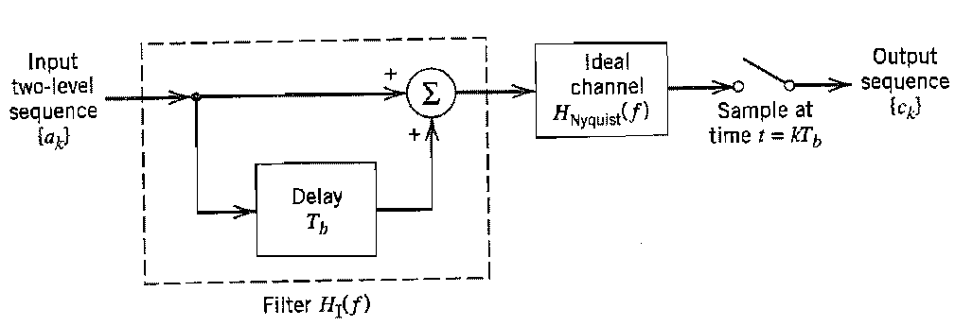
Duo binary encoder
Block diagram of the duo binary encoder

Slide 6
Physical meaning of duo binary level coding
The transformation described by $c_{k}=a_{k}+a_{k−1}$ changes the input two level sequence of uncorrelated binary sequence $\left\{a_{k}\right\}$ into a sequence of correlated three levels pulses $\left\{c_{k}\right\}$
This correlation between adjacent pulses may be viewed as introducing ISI in the transmitted signal in an artificial manner

Slide 7
Impulse response of the duo binary encoder
The impulse response of the duo binary encoder can be derived as follows
$$H_{I}\left(f\right)=H_{Nyquist}\left(f\right)\left[1+e^{−j2πfT_{b}}\right]$$
$$H_{I}\left(f\right)=H_{Nyquist}\left(f\right)\left[e^{jπfT_{b}}+e^{−jπfT_{b}}\right]e^{−jπfT_{b}}$$
$$H_{I}\left(f\right)=2H_{Nyquist}\left(f\right)cos⁡(πfT_{b})e^{−jπfT_{b}}$$

Slide 8
Impulse response of the duo binary encoder
Recall from the ISI section that the frequency response of an ideal Nyquist channel was defined by
$$H_{Nyquist}\left(f\right)=\left\{\begin{matrix}1 & −\frac{1}{2T_{b}}≤f≤\frac{1}{2T_{b}} \\ 0 & otherwise\end{matrix}\right\}$$
Now the frequency response of the duo binary encoder became
$$H_{I}\left(f\right)=\left\{\begin{matrix}2cos⁡(2πfT_{b})e^{−j2πfT_{b}} & −\frac{1}{2T_{b}}≤f≤\frac{1}{2T_{b}} \\ 0 & otherwise\end{matrix}\right\}$$

Slide 9
Graphical representation of $H_{I}(f)$

Slide 10
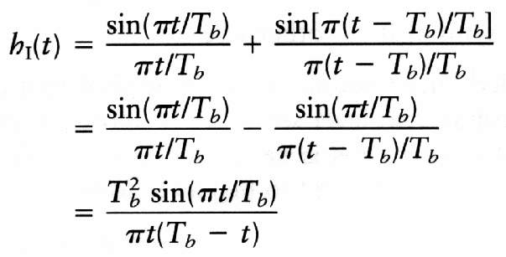
The impulse response of the duo binary encoder $H_{I}(f)$

Slide 11
Notes about $H_{I}(f)$
The response of a pulse is spread over more than one signaling interval
The response is partial in any signaling interval

Slide 12
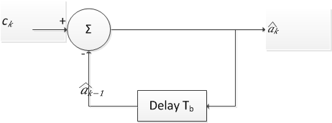
Detection (decoding) of duo binary signals
In order to detect or recover the bits into its original format we can reverse the operation made in the modulator according to following equation
$${\hat{a}}_{k}=c_{k}−{\hat{a}}_{k−1}$$
Decision feed back

Slide 13
Example of duo binary coding and decoding
Consider the binary sequence$b_{k}=0010110$ find the coded sequence $\left\{c_{k}\right\}$ and the decoded sequence $\left\{{\hat{a}}_{k}\right\}$ assume the first bit is the reference bit
$\begin{matrix}b_{k} \\ a_{k} \\ c_{k}\end{matrix}$
$\begin{matrix}{\hat{a}}_{k} \\ {\hat{b}}_{k}\end{matrix}$
Ref bit
$$c_{k}=a_{k}+a_{k−1}$$
$${\hat{a}}_{k}=c_{k}−{\hat{a}}_{k−1}$$

Slide 14
Short comings of duo binary coding
The duo binary coding suffers from two shortcomings
If one a given bit received in error, then the error tends to propagate in the succeeding bits. This known as error propagation
It can be seen from the $\left|H_{I}(f)\right|$ the frequency response contains a DC components which makes it improper for AC communication channels

Slide 15
Error propagation
Error propagation can be solved by using pre-coding
In pre-coding the binary sequence $\left\{b_{k}\right\}$ is converted into another binary sequence $\left\{d_{k}\right\}$ according to
$$d_{k}=b_{k}⊕d_{k−1}$$
Where the $⊕$ denotes modulo-two addition (XOR)

Slide 16
Block diagram of duo binary encoder with pre-coding

Slide 17
Duo binary sequence $c_{k}$ with pre-coding notes
The coded sequence $\left\{c_{k}\right\}$ produced with pre-coding consists of three levels as illustrated by $c_{k}=a_{k}+a_{k−1}$
$$c_{k}=\left\{\begin{matrix}0 & if data symbol is 1 \\ ±2 & if data symbol is 0\end{matrix}\right\}$$

Slide 18
Detection of original binary data from $c_{k}$ pre-coding
It can be noticed that
$$\begin{matrix}if \left|c_{k}\right|<1 & symbol b_{k} is 1 \\ if \left|c_{k}\right|>1 & symbol b_{k} is 0\end{matrix}$$
From this discussion the decoder can be a simple rectifier followed by a decision device (comparator) as shown in the next slide

Slide 19
Block diagram of the detector with precoding

Slide 20
Example Duo binary coding with pre-coding

Slide 21
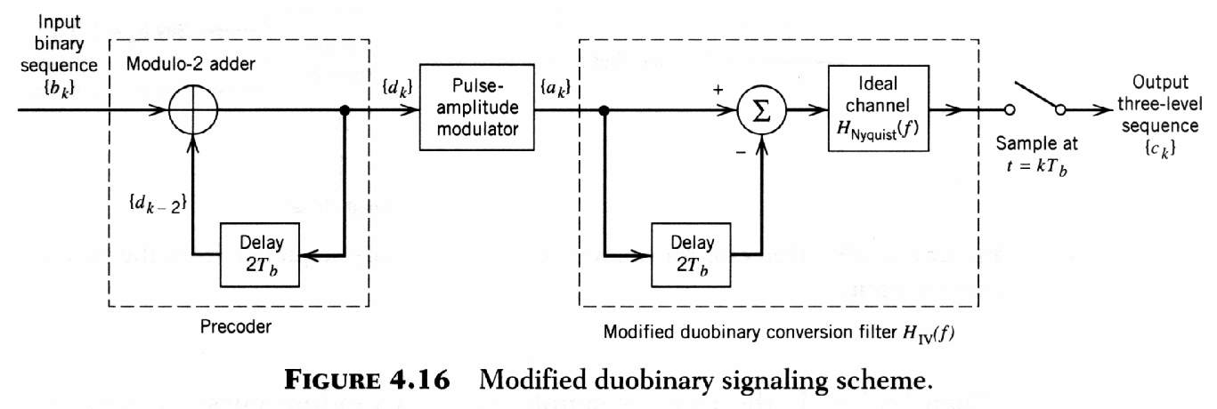
Modified duo binary signaling
In duo binary signaling, H(f) is nonzero at the origin
We can correct this deficiency by using the class IV partial response

Slide 22
Frequency response of the modified duo binary signaling

Slide 23
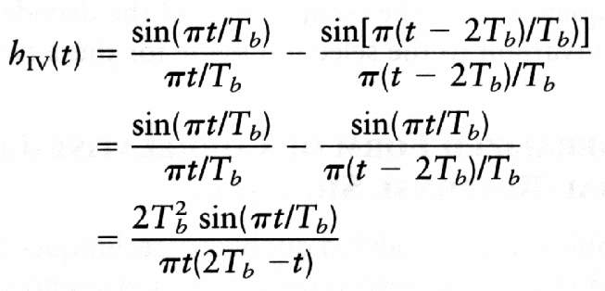
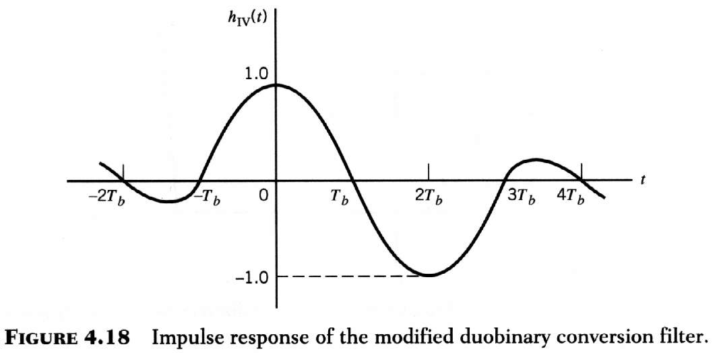
Impulse response of the modified duo binary signaling scheme
Time Sequency: interpretation of receiving 2, 0, and -2?

